Slide 1
Constructive Induction
CMSC 250

Slide 2
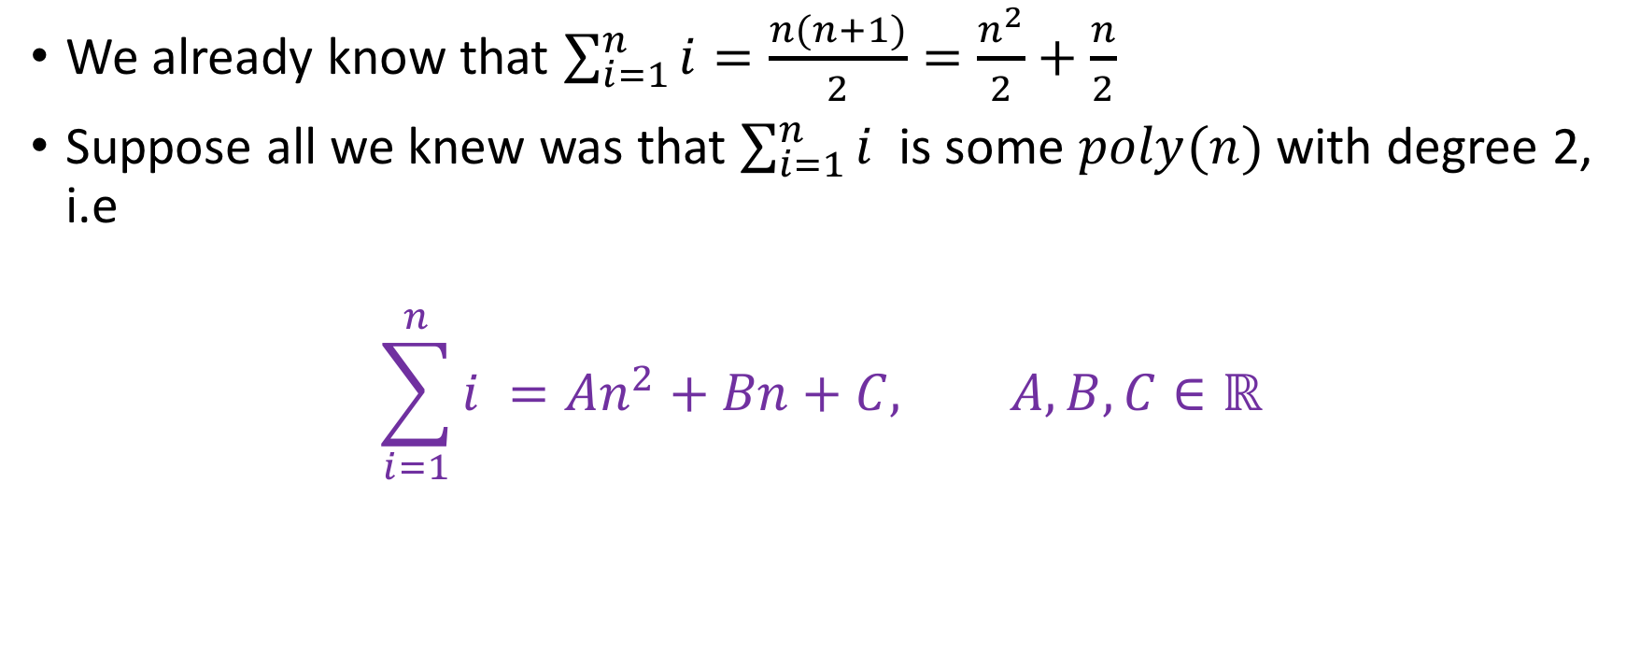
Introductory example
We already know that $\sum_{i=1}^{n}{i=\frac{n(n+1)}{2}=\frac{n^{2}}{2}+\frac{n}{2}}$
Suppose all we knew was that $\sum_{i=1}^{n}{i^{ }}$ is some $poly(n)$ with degree 2, i.e
$$\sum_{i=1}^{n}{i^{ }}=An^{2}+Bn+C, A, B,C∈ℝ$$

Slide 3
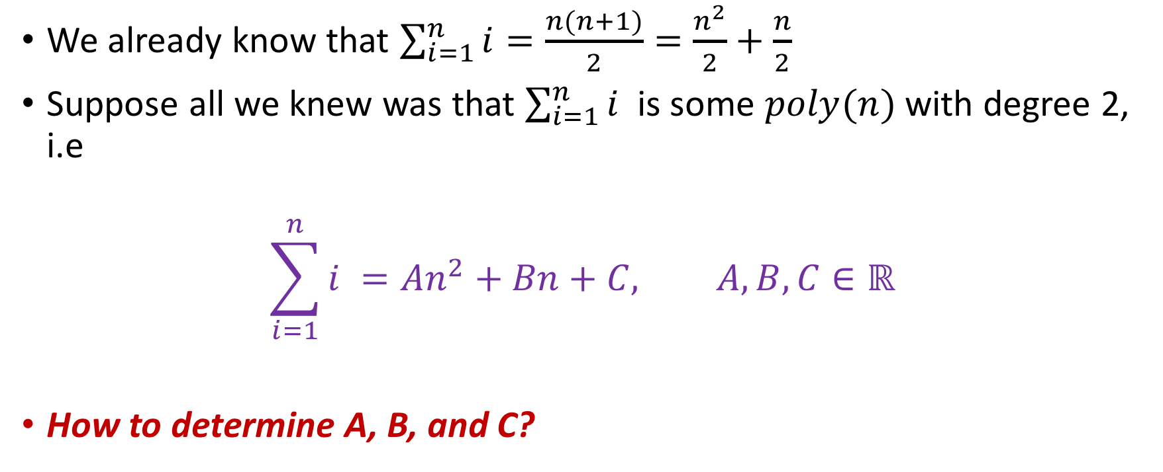
Introductory example
We already know that $\sum_{i=1}^{n}{i=\frac{n(n+1)}{2}=\frac{n^{2}}{2}+\frac{n}{2}}$
Suppose all we knew was that $\sum_{i=1}^{n}{i^{ }}$ is some $poly(n)$ with degree 2, i.e
$$\sum_{i=1}^{n}{i^{ }}=An^{2}+Bn+C, A, B,C∈ℝ$$
How to determine A, B, and C?

Slide 4
General logic
Solve as if you had an inductive proof (so IB, IH, IS)
For every step, we will establish conditions on A, B,C such that the relevant step is correct.
Contrast this with directly proving that every step is correct.

Slide 5
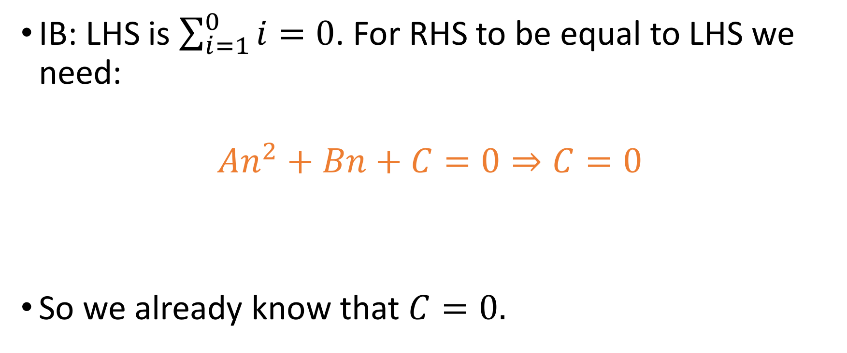

Constant $C$
IB: LHS is $\sum_{i=1}^{0}{i}=0$. For RHS to be equal to LHS we need:
$$An^{2}+Bn+C=0⇒C=0$$
So we already know that $C=0.$

Slide 6
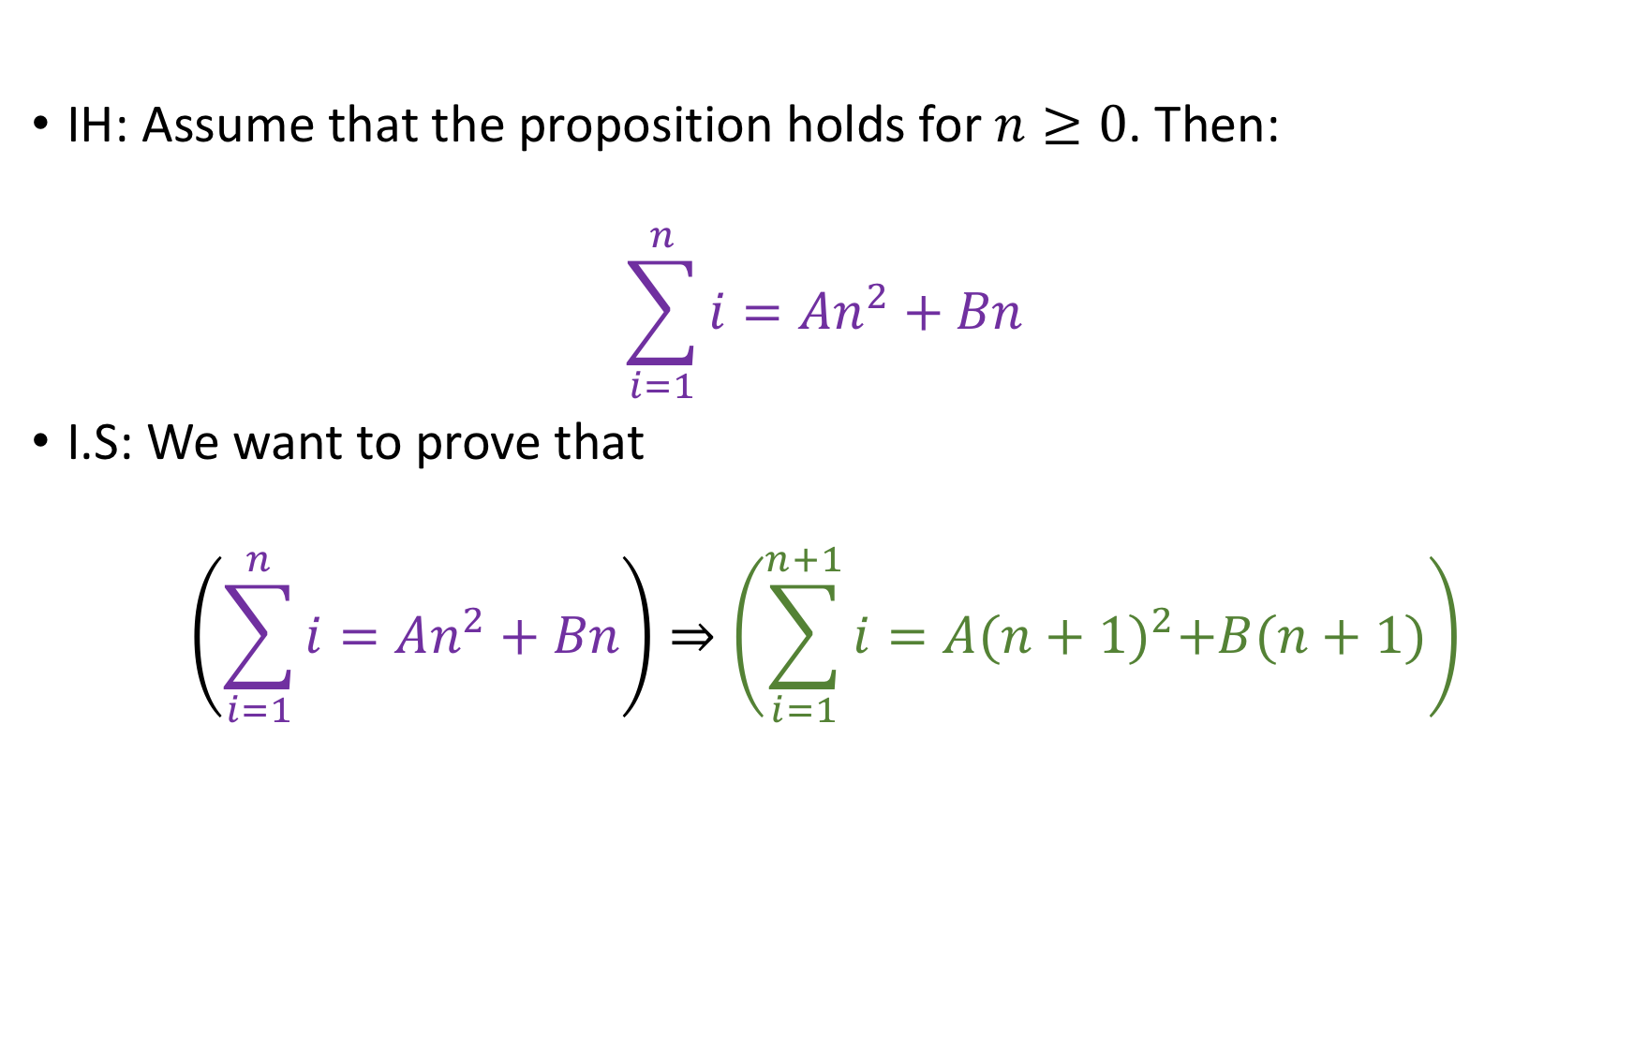

Co-efficients $A, B$
IH: Assume that the proposition holds for $n≥0$. Then:
$$\sum_{i=1}^{n}{i=An^{2}+Bn}$$
I.S: We want to prove that
$$\left(\sum_{i=1}^{n}{i=An^{2}+Bn}\right)⇒\left(\sum_{i=1}^{n+1}{i=A{(n+1)}^{2}+B(n+1)}\right)$$

Slide 7



Co-efficients $A, B$
IH: Assume that the proposition holds for $n≥0$. Then:
$$\sum_{i=1}^{n}{i=An^{2}+Bn}$$
I.S: We want to prove that
$$\left(\sum_{i=1}^{n}{i=An^{2}+Bn}\right)⇒\left(\sum_{i=1}^{n+1}{i=A{(n+1)}^{2}+B(n+1)}\right)$$
$$P(n)$$
$$P(n)$$
$$P(n+1)$$

Slide 8
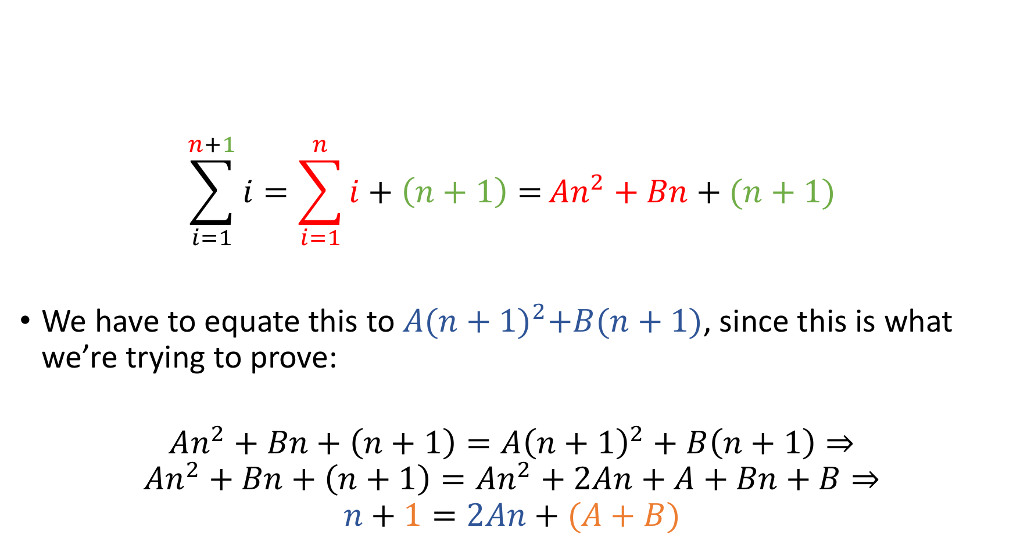
Co-efficients $A, B$
$$\sum_{i=1}^{n+1}{i}=\sum_{i=1}^{n}{i+\left(n+1\right)=}An^{2}+Bn+(n+1)$$
We have to equate this to $A{(n+1)}^{2}+B(n+1)$, since this is what we’re trying to prove:
$$An^{2}+Bn+\left(n+1\right)=A{\left(n+1\right)}^{2}+B\left(n+1\right)⇒ \\ An^{2}+Bn+\left(n+1\right)=An^{2}+2An+A+Bn+B⇒ \\ n+1=2An+(A+B)$$
I.H

Slide 9
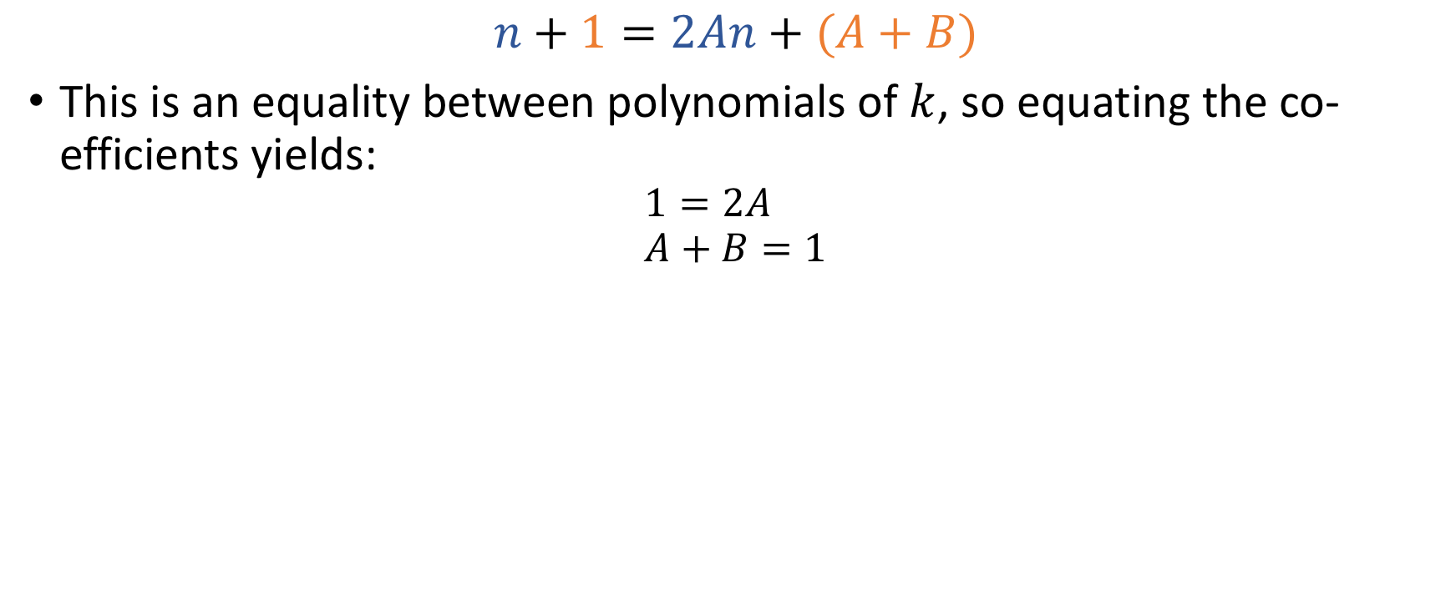
Co-efficients $A, B$
$$n+1=2An+(A+B)$$
This is an equality between polynomials of $k$, so equating the co-efficients yields:
$$1=2A \\ A+B=1$$

Slide 10
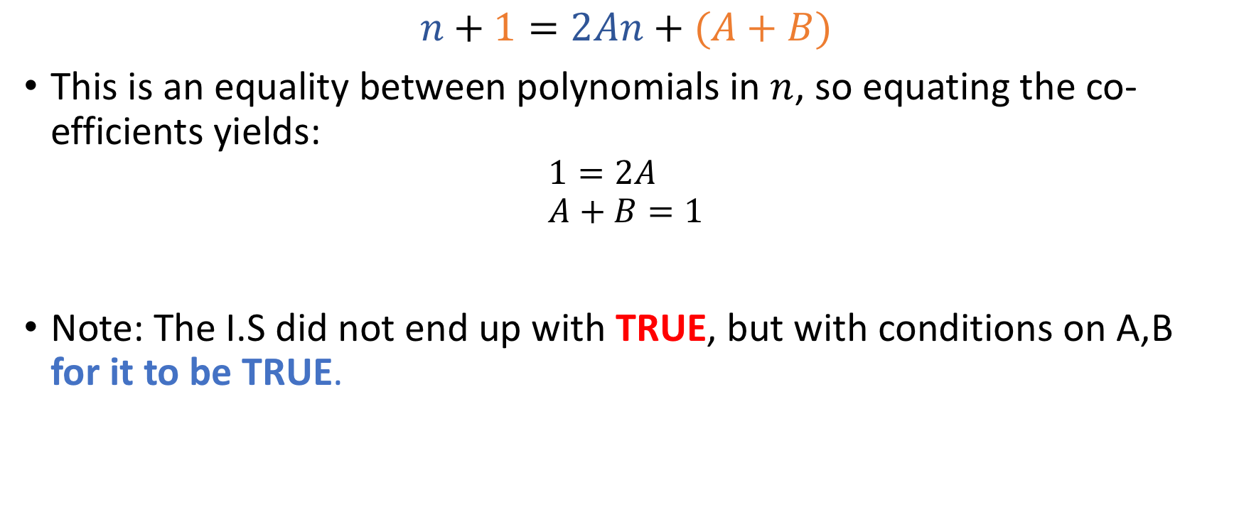
Co-efficients $A, B$
$$n+1=2An+(A+B)$$
This is an equality between polynomials in $n$, so equating the co-efficients yields:
$$1=2A \\ A+B=1$$
Note: The I.S did not end up with TRUE, but with conditions on A,B for it to be TRUE.

Slide 11
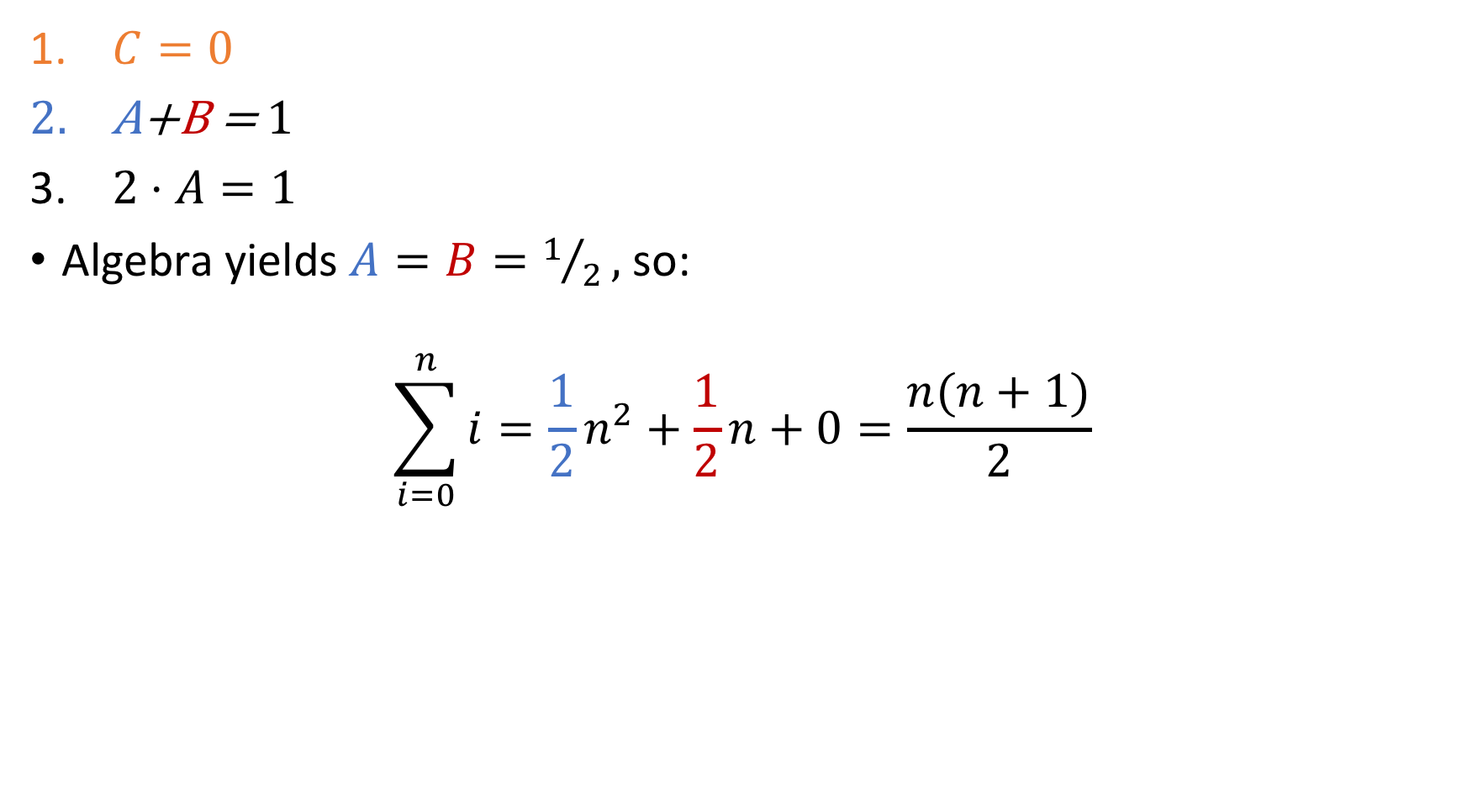
All our constraints
$C=0$
$\text{A}\text{+}\text{B}\text{ =} 1$
$2⋅A=1$
Algebra yields $A=B=1/2,$ so:
$$\sum_{i=0}^{n}{i=\frac{1}{2}n^{2}+\frac{1}{2}n+0=\frac{n(n+1)}{2}}$$

Slide 12
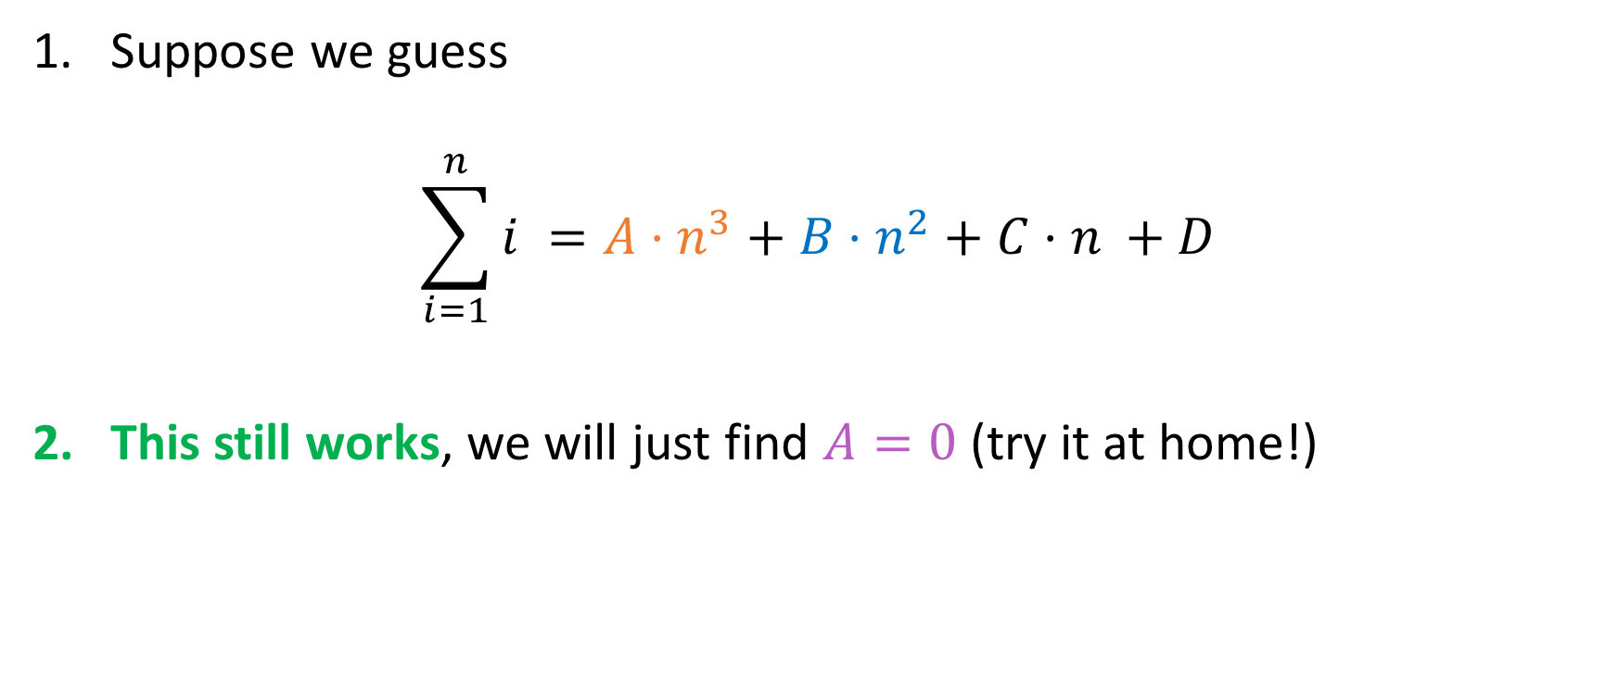
What if our guess is wrong (over)?
Suppose we guess
$$\sum_{i=1}^{n}{i^{ }=A⋅n^{3}+B⋅n^{2}+C⋅n^{ }+D}$$
This still works, we will just find $A=0$ (try it at home!)

Slide 13
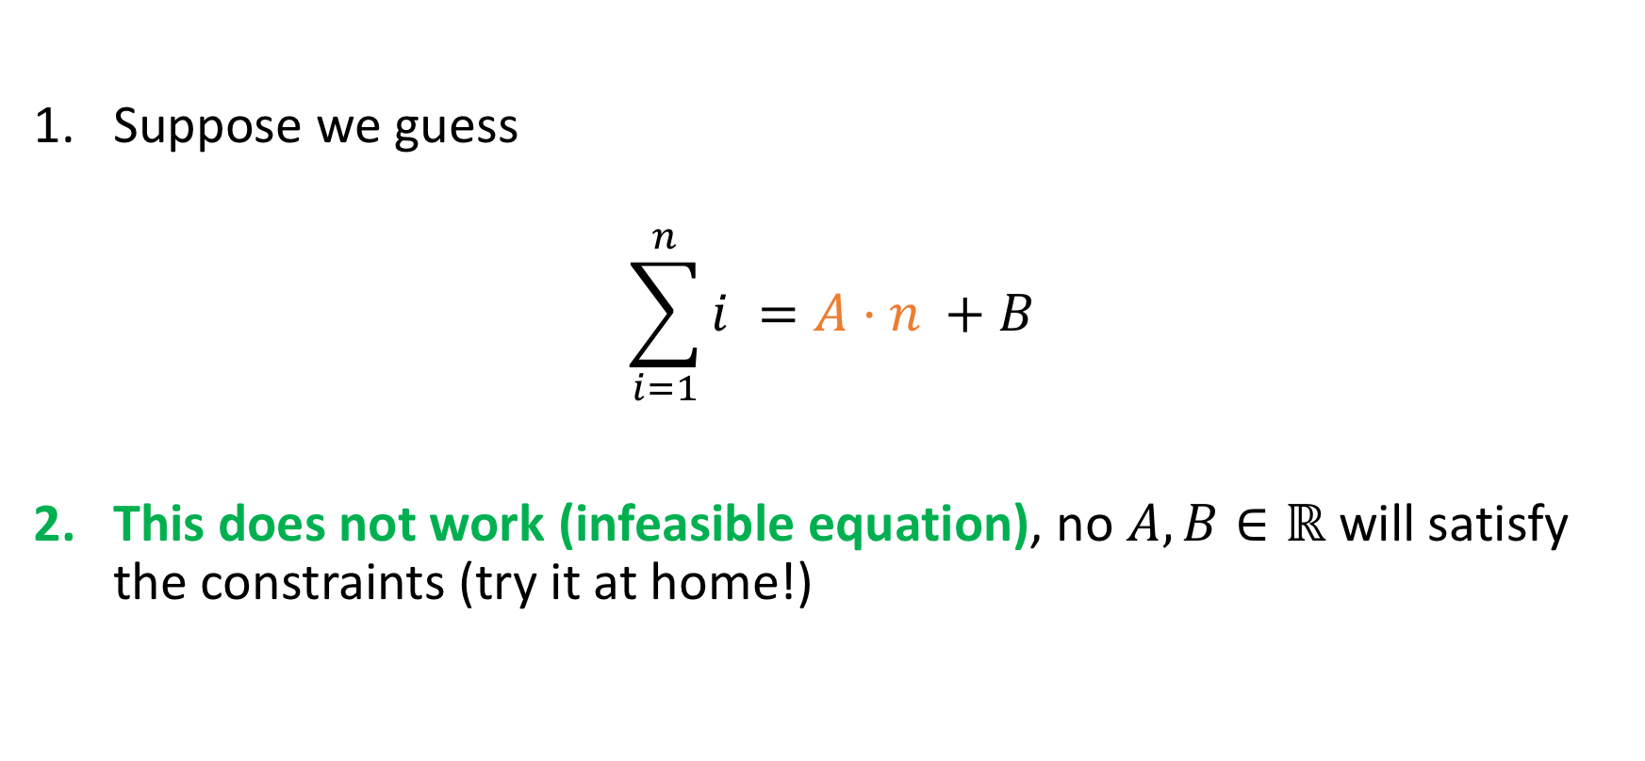
What if our guess is wrong (under)?
Suppose we guess
$$\sum_{i=1}^{n}{i^{ }=A⋅n^{ }+B}$$
This does not work (infeasible equation), no $A, B∈ℝ$ will satisfy the constraints (try it at home!)

Slide 14
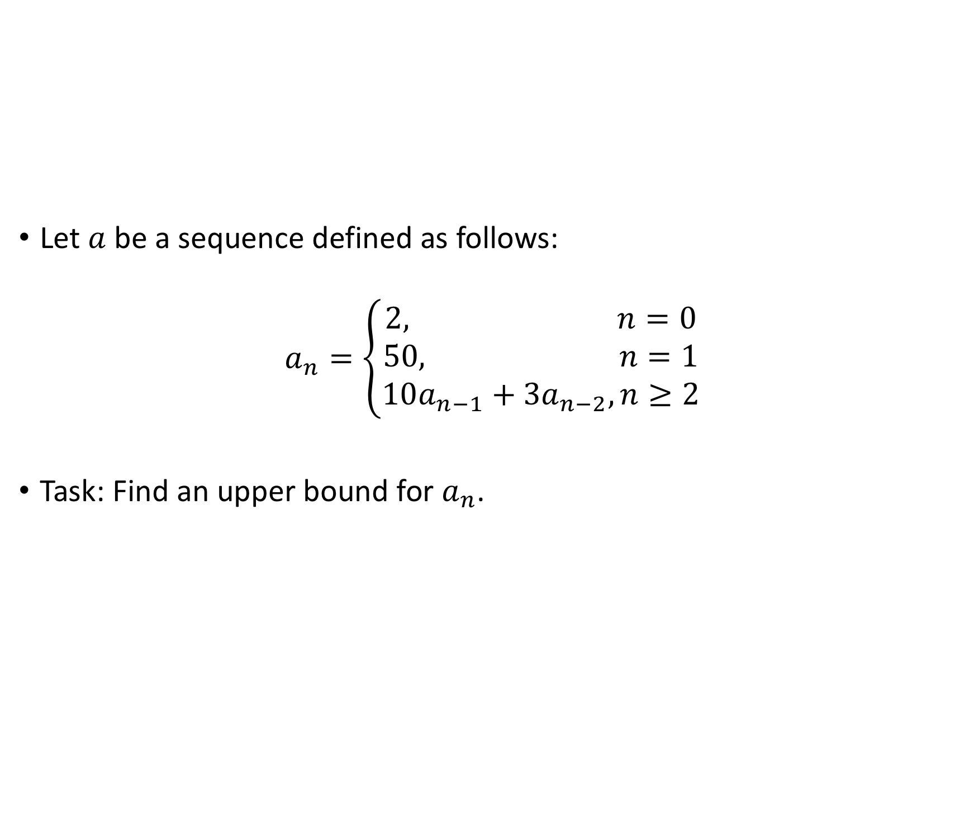
Another example (with bounds!)
Let $a$ be a sequence defined as follows:
$$a_{n}=\left\{\begin{aligned}2, n=0 \\ 50, n=1 \\ 10a_{n−1}+3a_{n−2}, n≥2\end{aligned}\right.$$
Task: Find an upper bound for $a_{n}$.

Slide 15
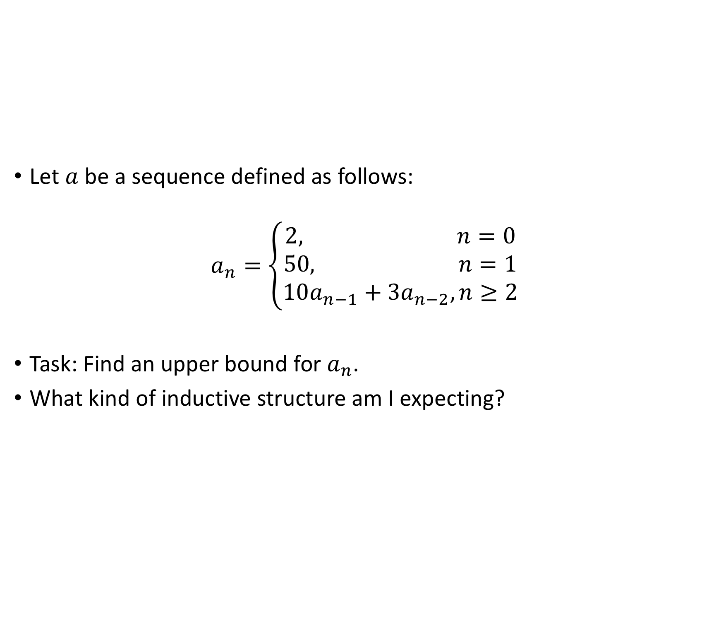
Another example (with bounds!)
Let $a$ be a sequence defined as follows:
$$a_{n}=\left\{\begin{aligned}2, n=0 \\ 50, n=1 \\ 10a_{n−1}+3a_{n−2}, n≥2\end{aligned}\right.$$
Task: Find an upper bound for $a_{n}$.
What kind of inductive structure am I expecting?
Weak
Strong

Slide 16
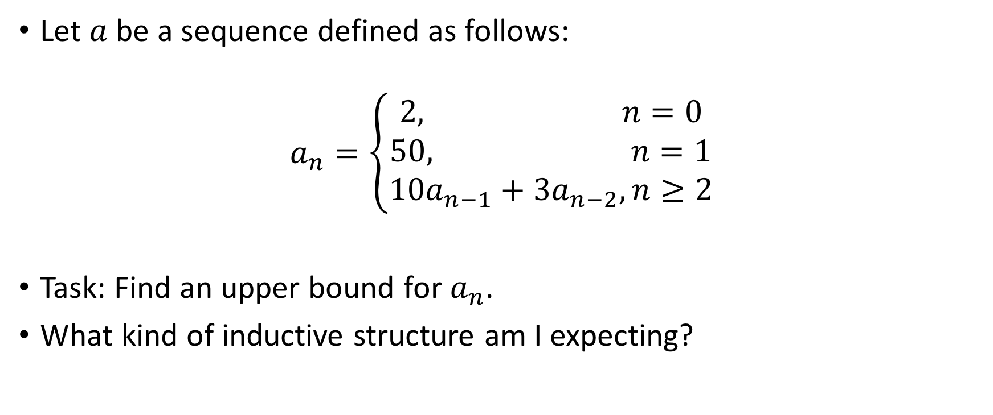
Another example (with bounds!)
Let $a$ be a sequence defined as follows:
$$a_{n}=\left\{\begin{aligned}2, n=0 \\ 50, n=1 \\ 10a_{n−1}+3a_{n−2}, n≥2\end{aligned}\right.$$
Task: Find an upper bound for $a_{n}$.
What kind of inductive structure am I expecting?
An inductive base with > 1 elements and a recursive rule with references to two prior terms hints towards strong induction…
Weak
Strong

Slide 17
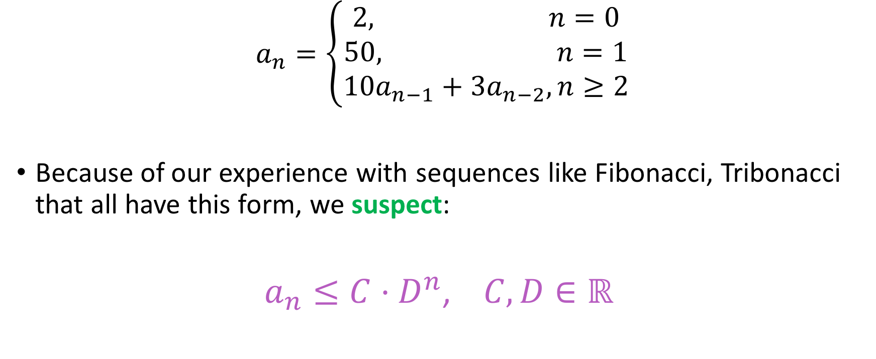
Key step
$$a_{n}=\left\{\begin{aligned}2, n=0 \\ 50, n=1 \\ 10a_{n−1}+3a_{n−2}, n≥2\end{aligned}\right.$$
Because of our experience with sequences like Fibonacci, Tribonacci that all have this form, we suspect:
$a_{n}≤C⋅D^{n}$, $C,D∈ℝ^{ }$

Slide 18
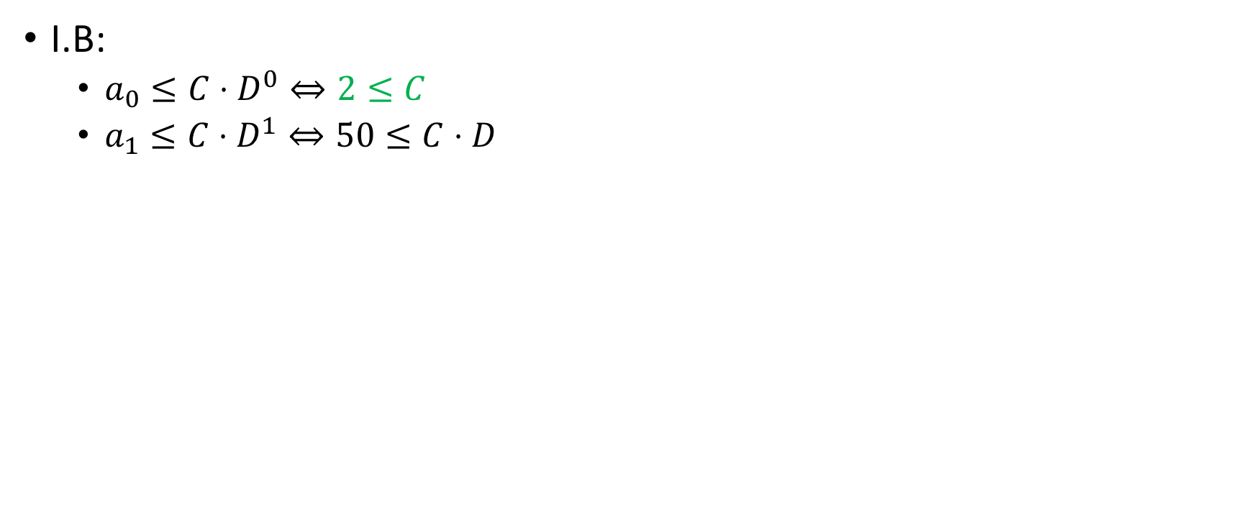
Constraints on C
I.B:
$a_{0}≤C⋅D^{0}⇔2≤C$
$a_{1}≤C⋅D^{1}⇔50≤C⋅D$

Slide 19
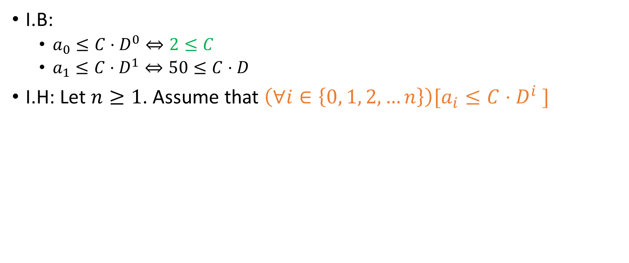
Inductive Hypothesis
I.B:
$a_{0}≤C⋅D^{0}⇔2≤C$
$a_{1}≤C⋅D^{1}⇔50≤C⋅D$
I.H: Let $n≥1$. Assume that $\left(∀i∈\left\{0, 1, 2, …n\right\}\right)[a_{i}≤C⋅D^{i} ]$

Slide 20
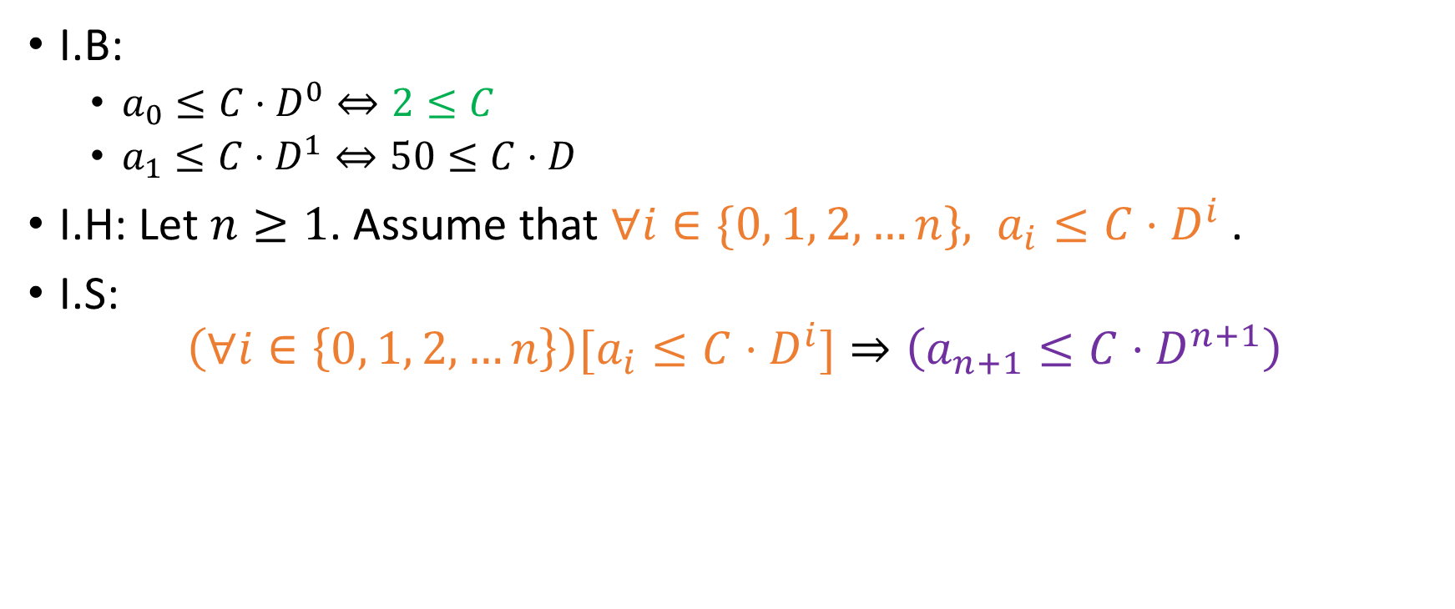
Inductive Step
I.B:
$a_{0}≤C⋅D^{0}⇔2≤C$
$a_{1}≤C⋅D^{1}⇔50≤C⋅D$
I.H: Let $n≥1$. Assume that $∀i∈\{0, 1, 2, …n\}, a_{i}≤C⋅D^{i}$.
I.S:
$$\left(∀i∈\left\{0, 1, 2, …n\right\}\right)[a_{i}≤C⋅D^{i}]⇒\left(a_{n+1}≤C⋅D^{n+1}\right)$$

Slide 21
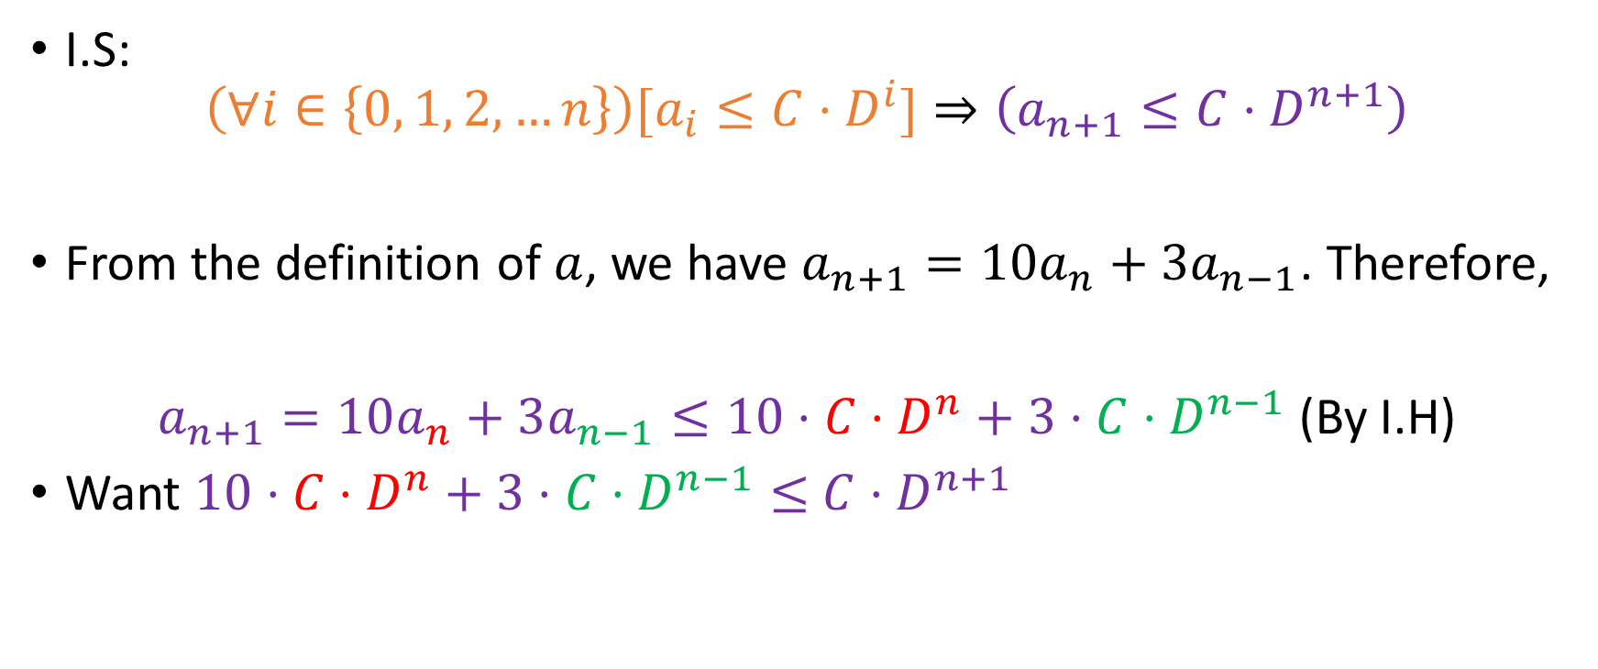
Inductive Step
I.S:
$$\left(∀i∈\left\{0, 1, 2, …n\right\}\right)[a_{i}≤C⋅D^{i}]⇒\left(a_{n+1}≤C⋅D^{n+1}\right)$$
From the definition of $a$, we have $a_{n+1}=10a_{n}+3a_{n−1}$. Therefore,
$a_{n+1}=10a_{n}+3a_{n−1}≤10⋅C⋅D^{n}+3⋅C⋅D^{n−1}$ (By I.H)
Want $10⋅C⋅D^{n}+3⋅C⋅D^{n−1}≤$ $C⋅D^{n+1}$

Slide 22

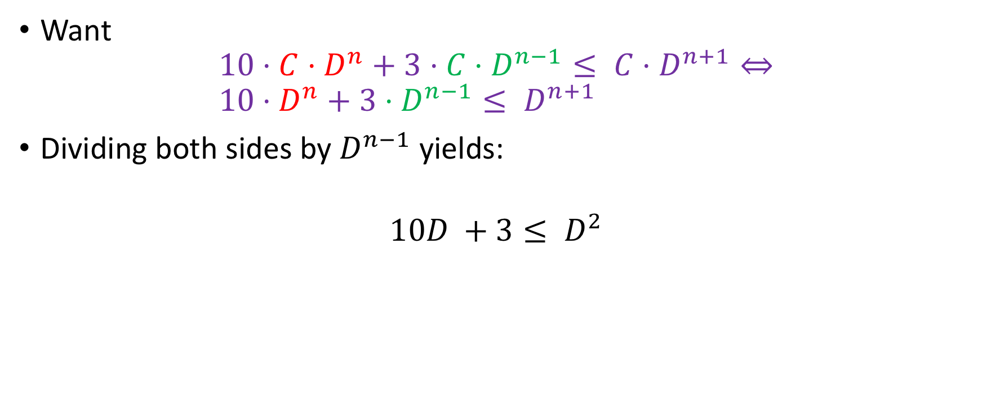
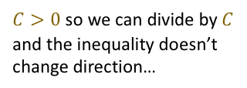
Inductive Step
$C>0$ so we can divide by $C$ and the inequality doesn’t change direction…
$\text{Want}$
$$10⋅C⋅D^{n}+3⋅C⋅D^{n−1}≤ C⋅D^{n+1}⇔ \\ 10⋅D^{n}+3⋅D^{n−1}≤ D^{n+1}$$
Dividing both sides by $D^{n−1}$ yields:
$$10D^{ }+3≤ D^{2}$$

Slide 23
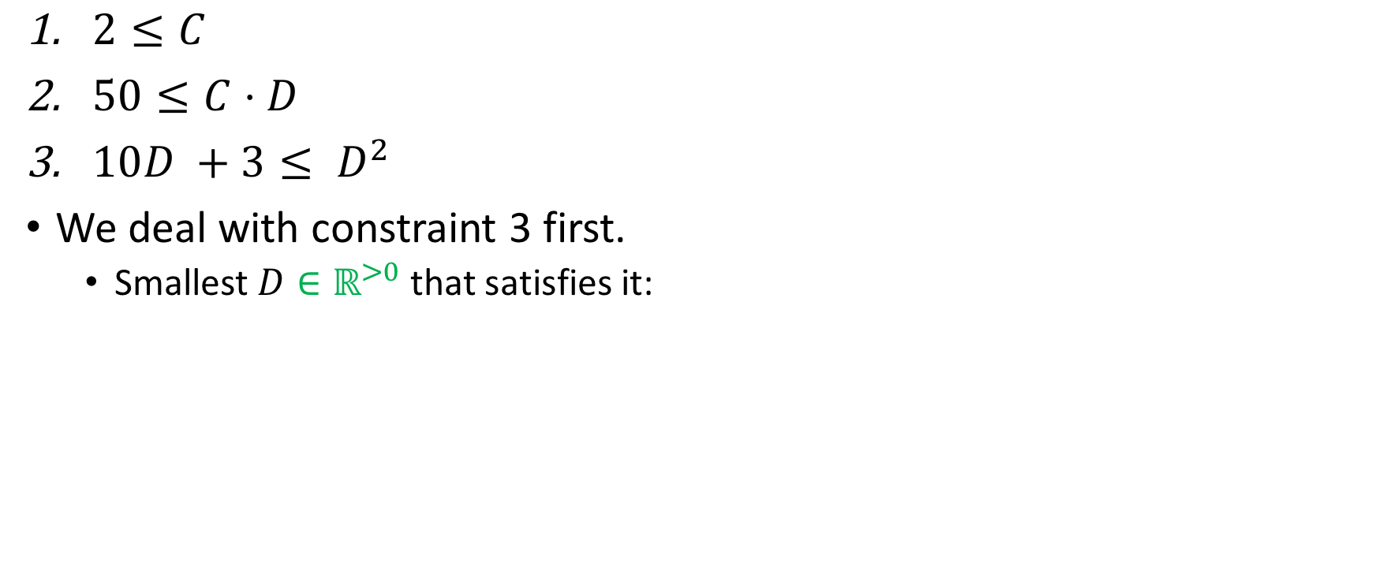
All constraints
$2≤C$
$50≤C⋅D$
$10D^{ }+3≤ D^{2}$
We deal with constraint 3 first.
Smallest $D∈ℝ^{>0}$ that satisfies it:

Slide 24
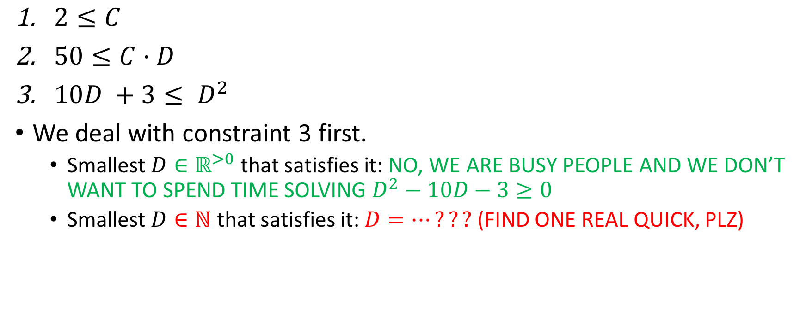
All constraints
$2≤C$
$50≤C⋅D$
$10D^{ }+3≤ D^{2}$
We deal with constraint 3 first.
Smallest $D∈ℝ^{>0}$ that satisfies it: NO, WE ARE BUSY PEOPLE AND WE DON’T WANT TO SPEND TIME SOLVING $D^{2}−10D−3≥0$
Smallest $D∈ℕ$ that satisfies it: $D=…???$ (FIND ONE REAL QUICK, PLZ)

Slide 25
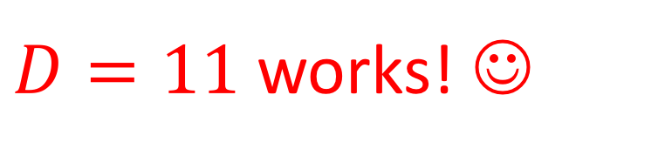
All constraints
$2≤C$
$50≤C⋅D$
$10D^{ }+3≤ D^{2}$
We deal with constraint 3 first.
Smallest $D∈ℝ^{>0}$ that satisfies it: NO, WE ARE BUSY PEOPLE AND WE DON’T WANT TO SPEND TIME SOLVING $D^{2}−10D−3≥0$
Smallest $D∈ℕ$ that satisfies it: $D=…???$ (FIND ONE REAL QUICK, PLZ)
$D=11$ works! ☺

Slide 26
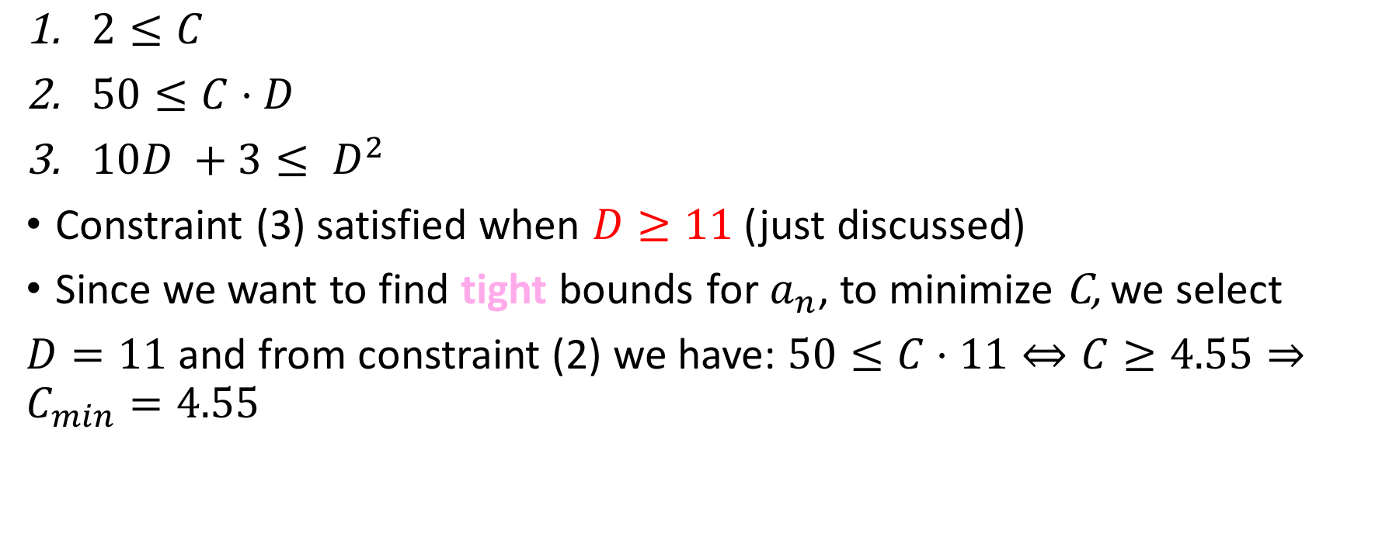
All constraints
$2≤C$
$50≤C⋅D$
$10D^{ }+3≤ D^{2}$
Constraint (3) satisfied when $D≥11$ (just discussed)
Since we want to find tight bounds for $a_{n}$, to minimize C, we select
$D=11$ and from constraint (2) we have: $50≤C⋅11⇔C≥4.55⇒C_{min}=4.55$

Slide 27
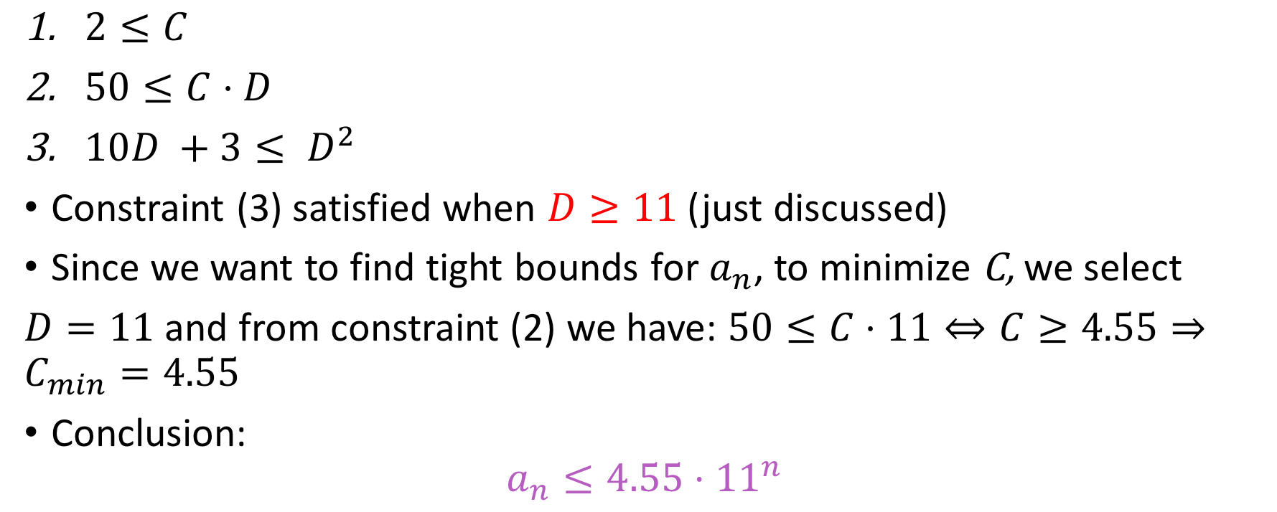
All constraints
$2≤C$
$50≤C⋅D$
$10D^{ }+3≤ D^{2}$
Constraint (3) satisfied when $D≥11$ (just discussed)
Since we want to find tight bounds for $a_{n}$, to minimize C, we select
$D=11$ and from constraint (2) we have: $50≤C⋅11⇔C≥4.55⇒C_{min}=4.55$
Conclusion:
$$a_{n}≤4.55⋅{11}^{n}$$

Slide 28
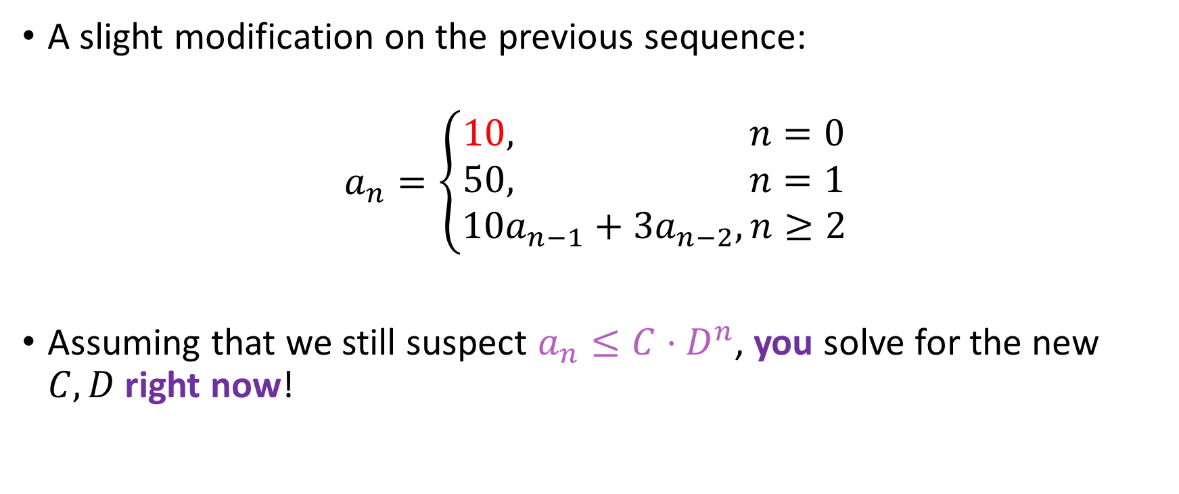
Work on this
A slight modification on the previous sequence:
$$a_{n}=\left\{\begin{aligned}10, n=0 \\ 50, n=1 \\ 10a_{n−1}+3a_{n−2}, n≥2\end{aligned}\right.$$
Assuming that we still suspect $a_{n}≤C⋅D^{n}$, you solve for the new $C,D$ right now!

Slide 29
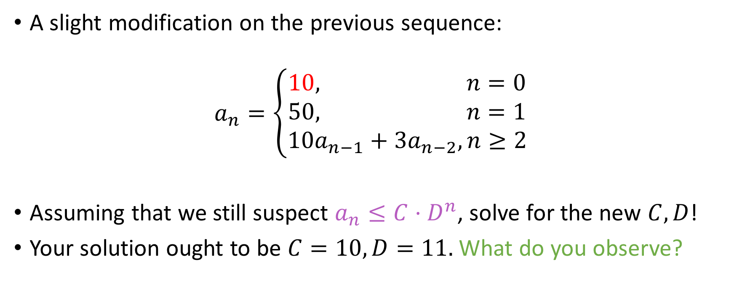
Work on this
A slight modification on the previous sequence:
$$a_{n}=\left\{\begin{aligned}10, n=0 \\ 50, n=1 \\ 10a_{n−1}+3a_{n−2}, n≥2\end{aligned}\right.$$
Assuming that we still suspect $a_{n}≤C⋅D^{n}$, solve for the new $C,D$!
Your solution ought to be $C=10, D=11.$ What do you observe?

Slide 30
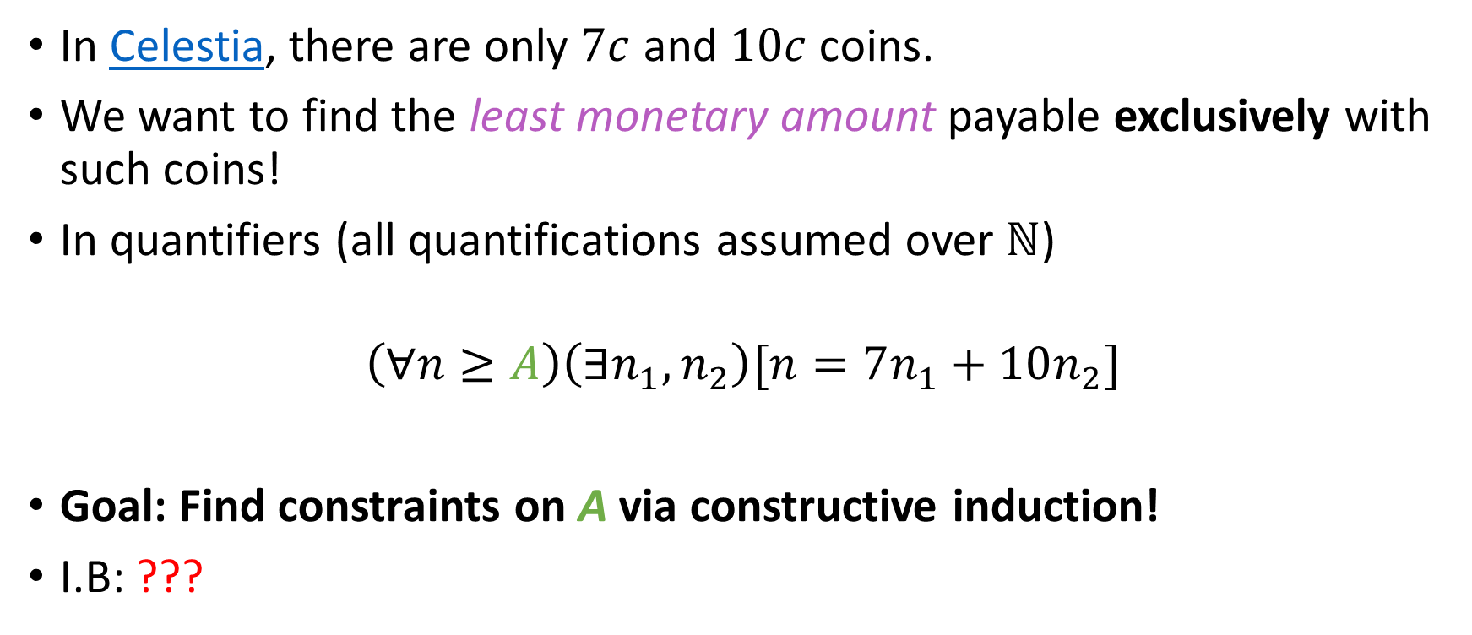
Coin problem
In Celestia, there are only $7c$ and $10c$ coins.
We want to find the least monetary amount payable exclusively with such coins!
In quantifiers (all quantifications assumed over $ℕ$)
$$\left(∀n≥A\right)\left(∃n_{1},n_{2}\right)[n=7n_{1}+10n_{2}]$$
Goal: Find constraints on A via constructive induction!
I.B: ???

Slide 31

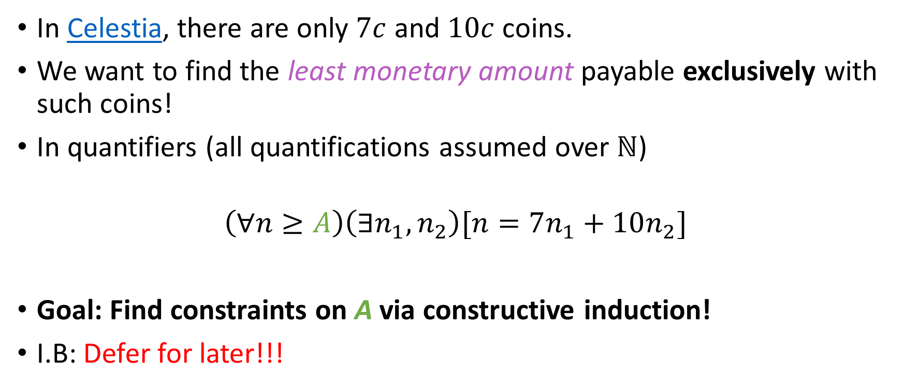
Coin problem
In Celestia, there are only $7c$ and $10c$ coins.
We want to find the least monetary amount payable exclusively with such coins!
In quantifiers (all quantifications assumed over $ℕ$)
$$\left(∀n≥A\right)\left(∃n_{1},n_{2}\right)[n=7n_{1}+10n_{2}]$$
Goal: Find constraints on A via constructive induction!
I.B: Defer for later!!!

Slide 32
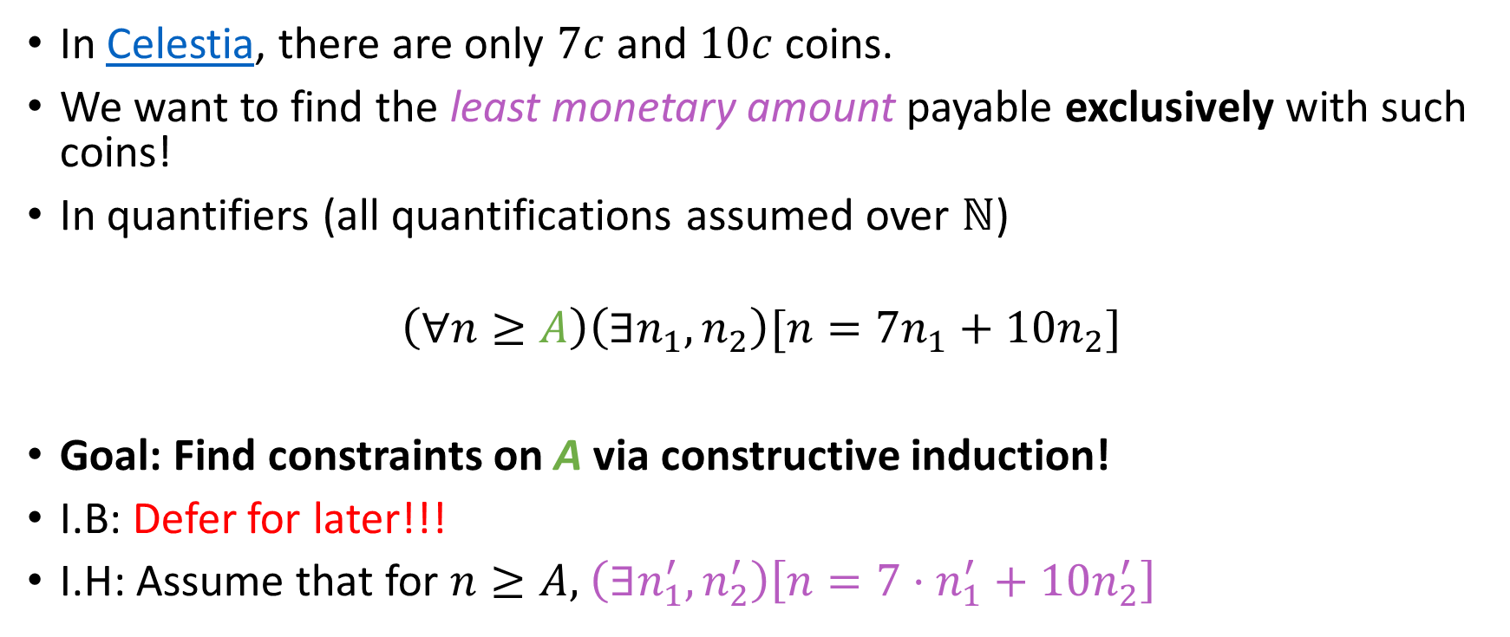
Coin problem
In Celestia, there are only $7c$ and $10c$ coins.
We want to find the least monetary amount payable exclusively with such coins!
In quantifiers (all quantifications assumed over $ℕ$)
$$\left(∀n≥A\right)\left(∃n_{1},n_{2}\right)[n=7n_{1}+10n_{2}]$$
Goal: Find constraints on A via constructive induction!
I.B: Defer for later!!!
I.H: Assume that for $n≥A,$ $\left(∃n_{1}^{′},n_{2}^{′}\right)\left[n=7⋅n_{1}^{′}+10n_{2}^{′}\right]$

Slide 33
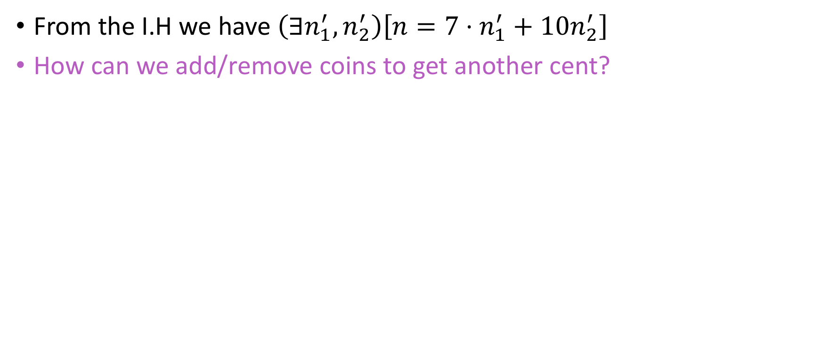
Coin problem (I.S)
From the I.H we have $\left(∃n_{1}^{′},n_{2}^{′}\right)\left[n=7⋅n_{1}^{′}+10n_{2}^{′}\right]$
How can we add/remove coins to get another cent?

Slide 34
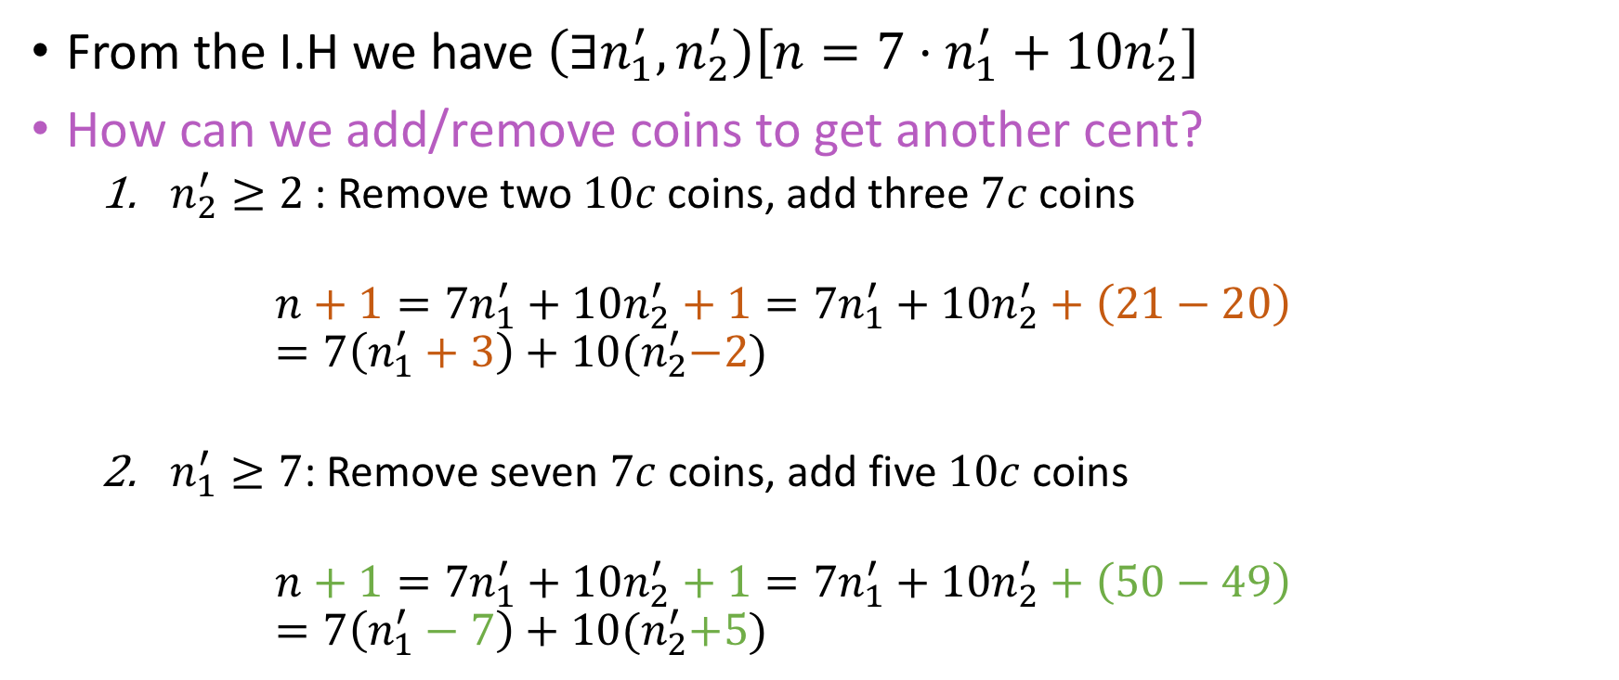
Coin problem (I.S)
From the I.H we have $\left(∃n_{1}^{′},n_{2}^{′}\right)\left[n=7⋅n_{1}^{′}+10n_{2}^{′}\right]$
How can we add/remove coins to get another cent?
${n_{2}^{′}≥2}^{ }$: Remove two $10c$ coins, add three $7c$ coins
$$n+1=7n_{1}^{′}+10n_{2}^{′}+1=7n_{1}^{′}+10n_{2}^{′}+\left(21−20\right)=7\left(n_{1}^{′}+3\right)+10{(n}_{2}^{′}−2)$$
$n_{1}^{′}≥7$: Remove seven $7c$ coins, add five $10c$ coins
$$n+1=7n_{1}^{′}+10n_{2}^{′}+1=7n_{1}^{′}+10n_{2}^{′}+\left(50−49\right)=7\left(n_{1}^{′}−7\right)+10{(n}_{2}^{′}+5)$$

Slide 35
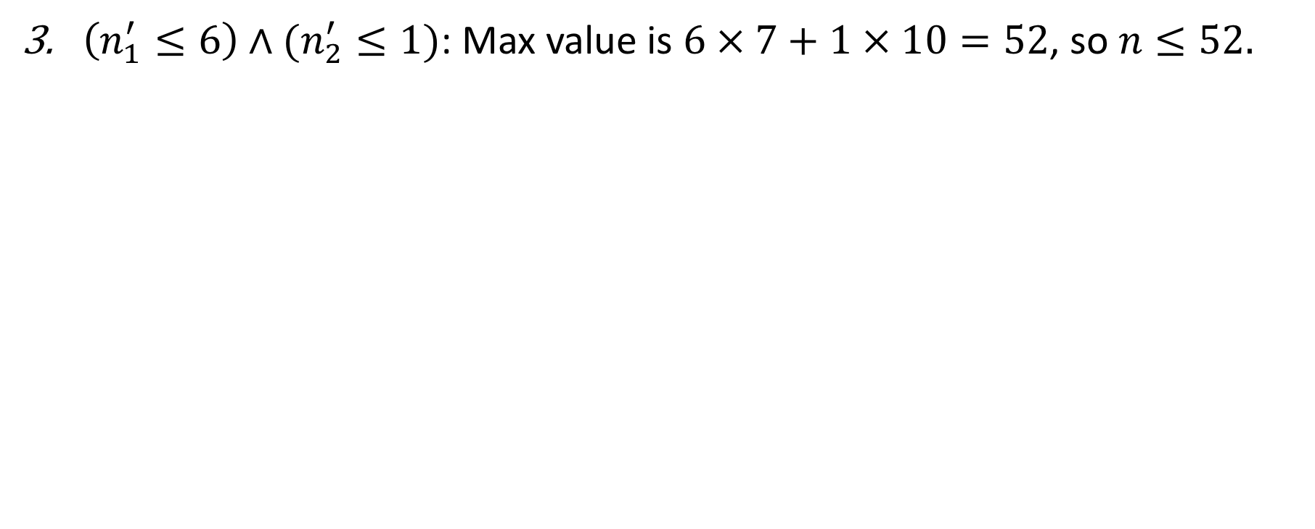
Coin problem (I.S)
$\left(n_{1}^{′}≤6\right)∧(n_{2}^{′}≤1)$: Max value is $6 × 7+1 × 10=52$, so$n≤52.$

Slide 36
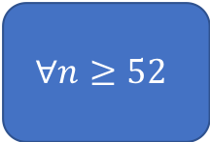
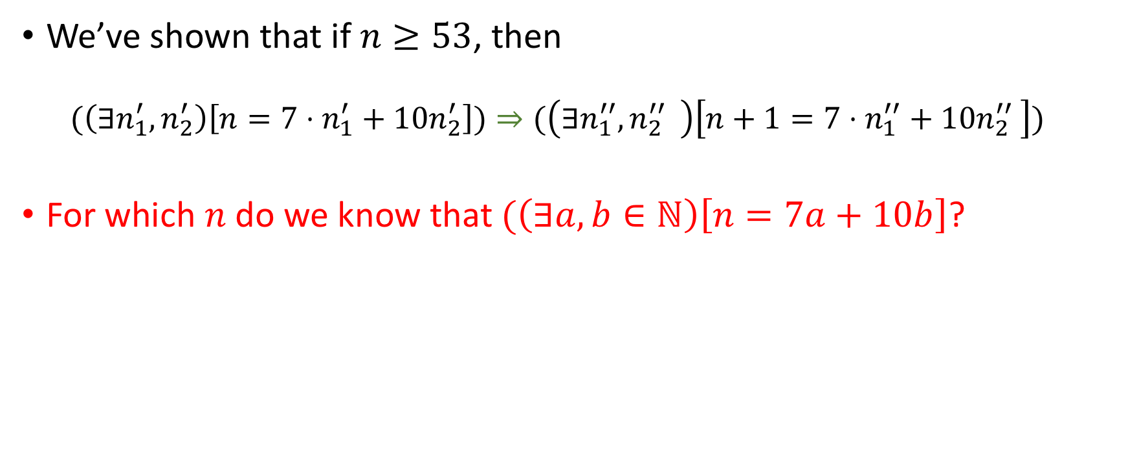
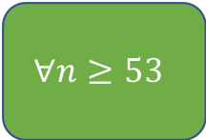
RECAP
We’ve shown that if $n≥53$, then
$$(\left(∃n_{1}^{′},n_{2}^{′}\right)\left[n=7⋅n_{1}^{′}+10n_{2}^{′}\right])⇒(\left(∃n_{1}^{′′},{{n_{2}^{′′}}^{ }}_{ }^{ }\right)\left[n+1=7⋅n_{1}^{′′}+10{n_{2}^{′′}}_{ }^{ }\right])$$
For which $n$ do we know that $(\left(∃a,b∈ℕ\right)\left[n=7a+10b\right]$?
$$∀n≥52$$
$$∀n≥53$$
Something Else

Slide 37

RECAP
We’ve shown that if $n≥53$, then
$$(\left(∃n_{1}^{′},n_{2}^{′}\right)\left[n=7⋅n_{1}^{′}+10n_{2}^{′}\right])⇒(\left(∃n_{1}^{′′},{{n_{2}^{′′}}^{ }}_{ }^{ }\right)\left[n+1=7⋅n_{1}^{′′}+10{n_{2}^{′′}}_{ }^{ }\right])$$
For which $n$ do we know that $(\left(∃a,b∈ℕ\right)\left[n=7a+10b\right]$?
$$∀n≥52$$
$$∀n≥53$$
Something Else
Only the implication holds! We don’t have any hard truth (base) about whether it EVER holds.

Slide 38
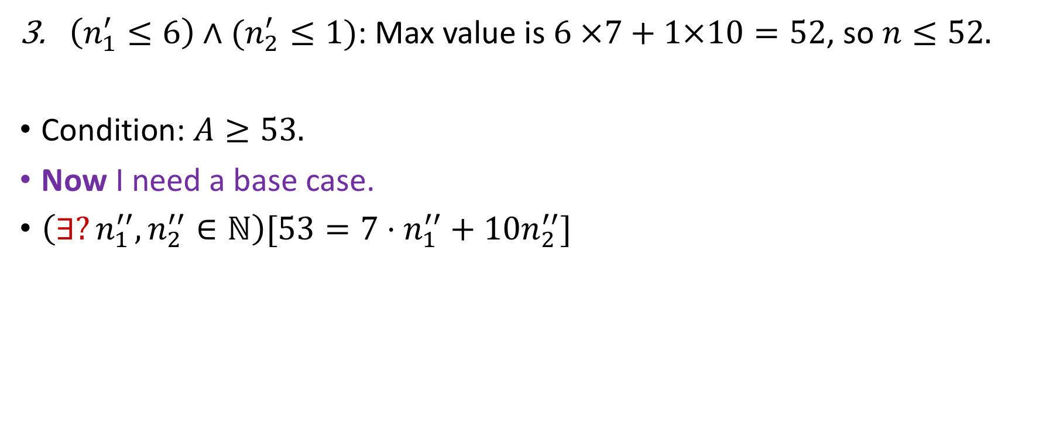
Coin problem (I.S)
$\left(n_{1}^{′}≤6\right)∧(n_{2}^{′}≤1)$: Max value is $6 ×7+1×10=52$, so $n≤52.$
Condition: $A≥53.$
Now I need a base case.
$\left(∃?n_{1}^{′′},n_{2}^{′′}∈ℕ\right)[53=7⋅n_{1}^{′′}+10n_{2}^{′′}]$
Yes (which?)
No

Slide 39
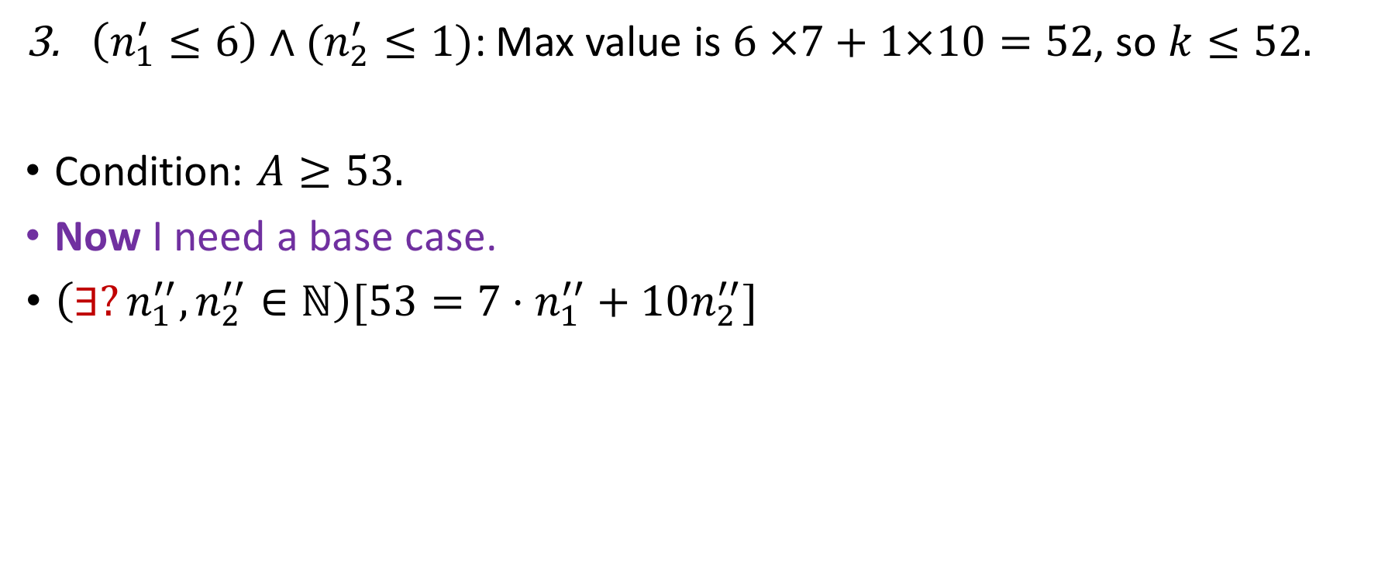
Coin problem (I.S)
$\left(n_{1}^{′}≤6\right)∧(n_{2}^{′}≤1)\text{:}$ Max value is $6 ×7+1×10=52$, so $k≤52.$
Condition: $A≥53.$
Now I need a base case.
$\left(∃?n_{1}^{′′},n_{2}^{′′}∈ℕ\right)[53=7⋅n_{1}^{′′}+10n_{2}^{′′}]$
Yes (which?)
No
Prove it at home (use cases)

Slide 40
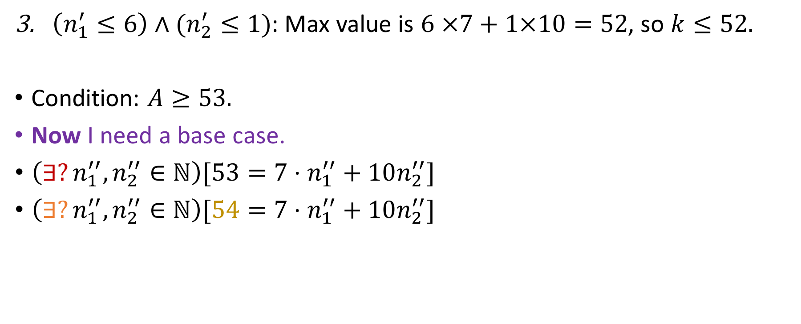
Coin problem (I.S)
$\left(n_{1}^{′}≤6\right)∧(n_{2}^{′}≤1)$: Max value is $6 ×7+1×10=52$, so $k≤52.$
Condition: $A≥53.$
Now I need a base case.
$\left(∃?n_{1}^{′′},n_{2}^{′′}∈ℕ\right)[53=7⋅n_{1}^{′′}+10n_{2}^{′′}]$
$\left(∃?n_{1}^{′′},n_{2}^{′′}∈ℕ\right)[54=7⋅n_{1}^{′′}+10n_{2}^{′′}]$
Yes (which?)
No

Slide 41
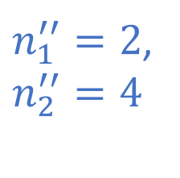
Coin problem (I.S)
$\left(n_{1}^{′}≤6\right)∧(n_{2}^{′}≤1)$: Max value is $6 ×7+1×10=52$, so $k≤52.$
Condition: $A≥53.$
Now I need a base case.
$\left(∃?n_{1}^{′′},n_{2}^{′′}∈ℕ\right)[53=7⋅n_{1}^{′′}+10n_{2}^{′′}]$
$\left(∃?n_{1}^{′′},n_{2}^{′′}∈ℕ\right)[54=7⋅n_{1}^{′′}+10n_{2}^{′′}]$
Yes (which?)
No
$n_{1}^{′′}=2$, $n_{2}^{′′}=4$

Slide 42
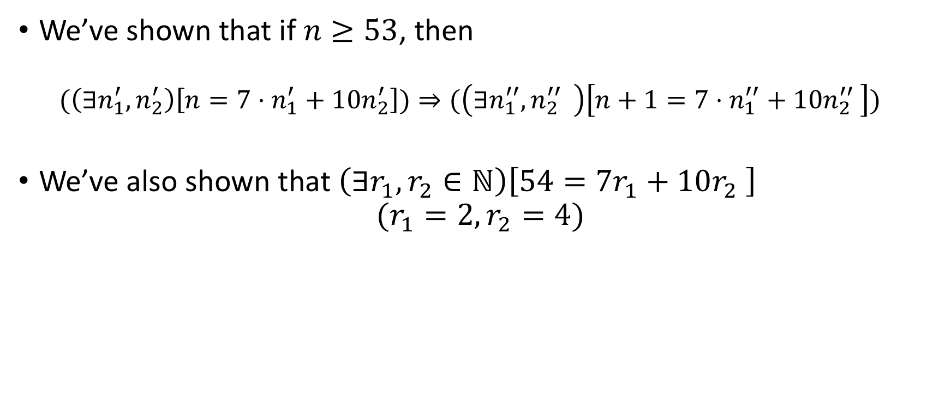
RECAP
We’ve shown that if $n≥53$, then
$$(\left(∃n_{1}^{′},n_{2}^{′}\right)\left[n=7⋅n_{1}^{′}+10n_{2}^{′}\right])⇒(\left(∃n_{1}^{′′},{{n_{2}^{′′}}^{ }}_{ }^{ }\right)\left[n+1=7⋅n_{1}^{′′}+10{n_{2}^{′′}}_{ }^{ }\right])$$
We’ve also shown that $\left(∃r_{1},r_{2}∈ℕ\right)\left[54=7r_{1}+10r_{2} \right]$ $(r_{1}=2, r_{2}=4)$

Slide 43
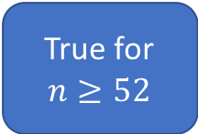
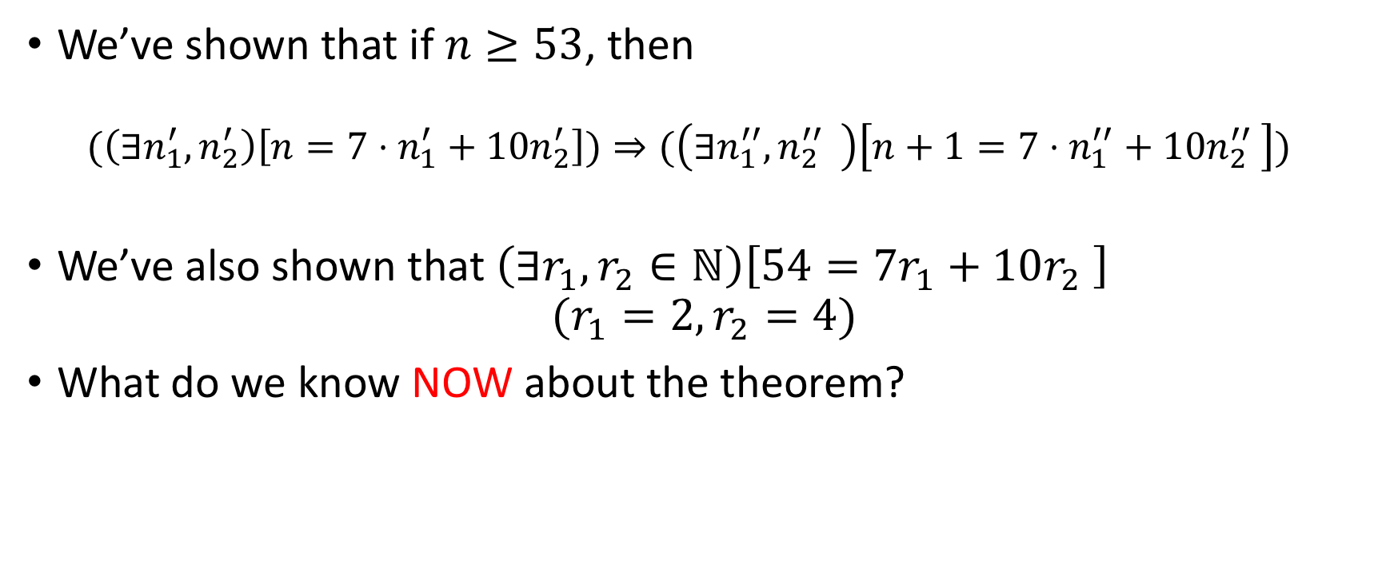
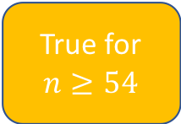
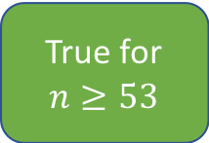
RECAP
We’ve shown that if $n≥53$, then
$$(\left(∃n_{1}^{′},n_{2}^{′}\right)\left[n=7⋅n_{1}^{′}+10n_{2}^{′}\right])⇒(\left(∃n_{1}^{′′},{{n_{2}^{′′}}^{ }}_{ }^{ }\right)\left[n+1=7⋅n_{1}^{′′}+10{n_{2}^{′′}}_{ }^{ }\right])$$
We’ve also shown that $\left(∃r_{1},r_{2}∈ℕ\right)\left[54=7r_{1}+10r_{2} \right]$ $(r_{1}=2, r_{2}=4)$
What do we know NOW about the theorem?
True for $n≥52$
True for $n≥53$
True for $n≥54$
Nothing

Slide 44
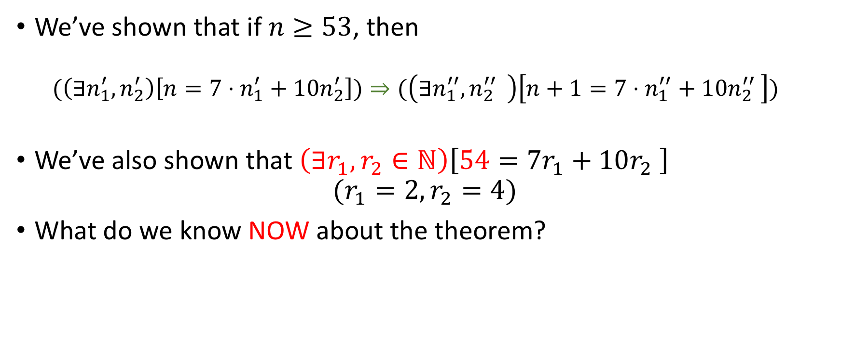
RECAP
We’ve shown that if $n≥53$, then
$$(\left(∃n_{1}^{′},n_{2}^{′}\right)\left[n=7⋅n_{1}^{′}+10n_{2}^{′}\right])⇒(\left(∃n_{1}^{′′},{{n_{2}^{′′}}^{ }}_{ }^{ }\right)\left[n+1=7⋅n_{1}^{′′}+10{n_{2}^{′′}}_{ }^{ }\right])$$
We’ve also shown that $\left(∃r_{1},r_{2}∈ℕ\right)\left[54=7r_{1}+10r_{2} \right]$ $(r_{1}=2, r_{2}=4)$
What do we know NOW about the theorem?
True for $n≥52$
True for $n≥53$
True for $n≥54$
Nothing

Slide 45
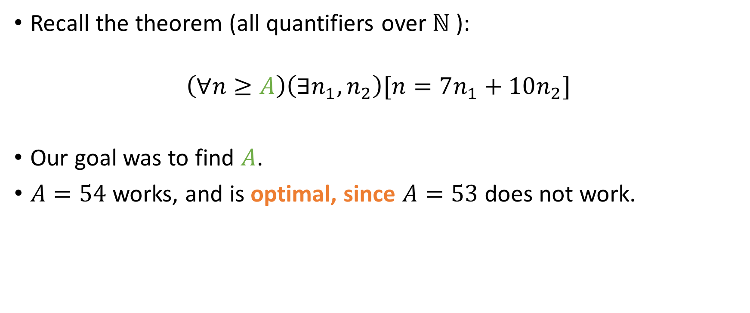
What is A?
Recall the theorem (all quantifiers over $ℕ$):
$$\left(∀n≥A\right)\left(∃n_{1},n_{2}\right)[n=7n_{1}+10n_{2}]$$
Our goal was to find $A$.
$A=54$ works, and is optimal, since $A=53$ does not work.

Slide 46
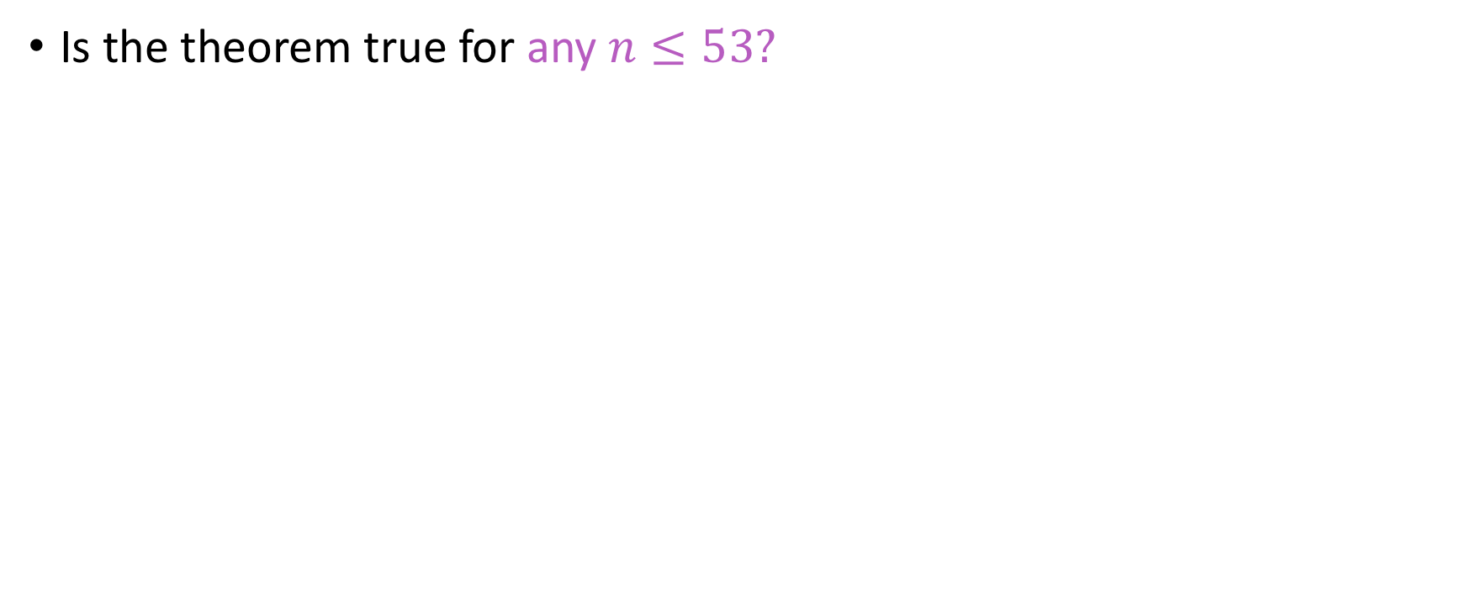
Question
Is the theorem true for any $n≤53?$
Yes (which?)
No (Why?)

Slide 47
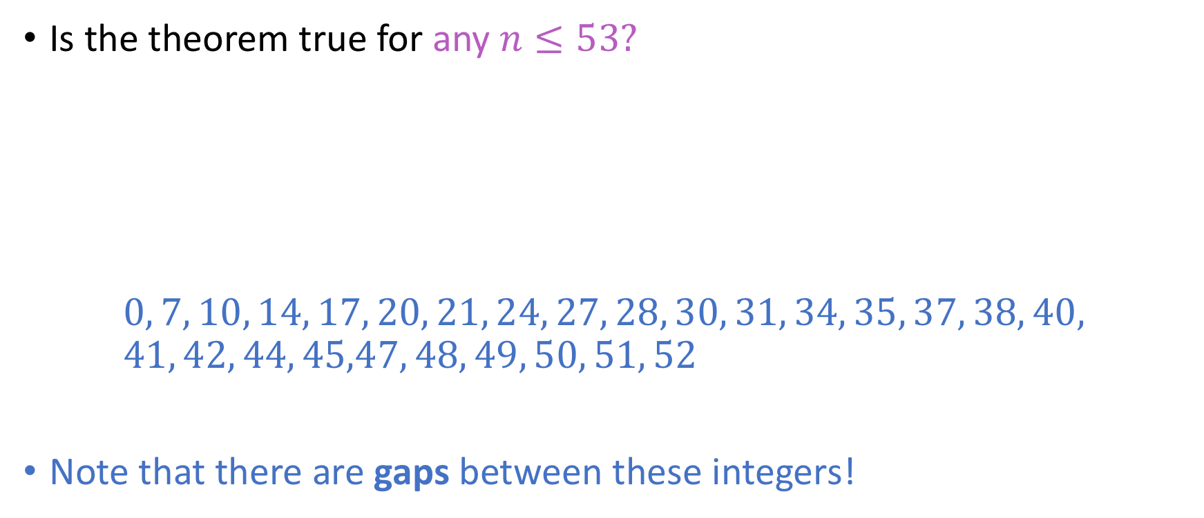
Question
Is the theorem true for any $n≤53?$
$$0, 7, 10, 14, 17, 20, 21, 24, 27, 28, 30, 31, 34, 35, 37, 38, 40, \\ 41, 42, 44, 45,47, 48, 49, 50, 51, 52$$
Note that there are gaps between these integers!
Yes (which?)
No (Why?)

Slide 48
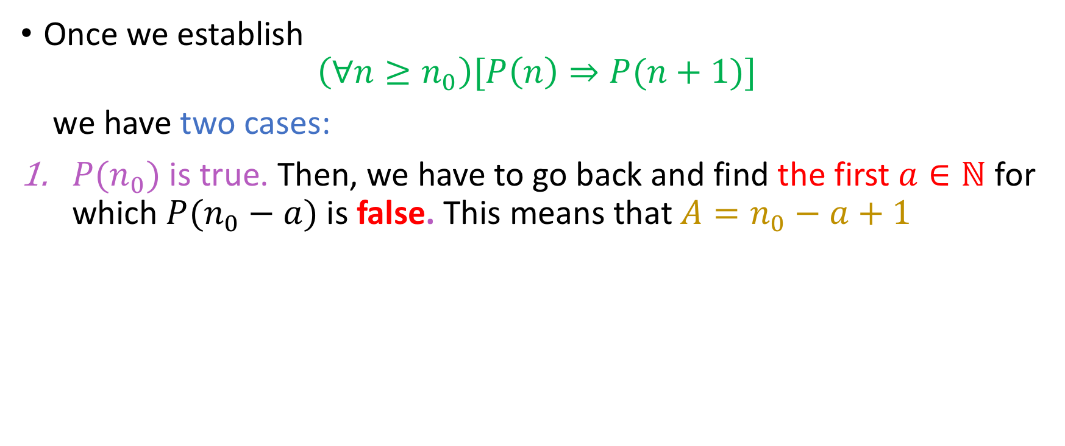
General Scenarios
Once we establish
$$\left(∀n≥n_{0}\right)[P\left(n\right)⇒P(n+1)]$$
we have two cases:
$P(n_{0})$ is true. Then, we have to go back and find the first $a∈ℕ$ for which $P(n_{0}−a)$ is false. This means that $A=n_{0}−a+1$
Notes:
“Just like we just did”

Slide 49









General Scenarios
Once we establish
$$\left(∀n≥n_{0}\right)[P\left(n\right)⇒P(n+1)]$$
we have two cases:
$P(n_{0})$ is true. Then, we have to go back and find the first $a∈ℕ$ for which $P(n_{0}−a)$ is false. This means that $A=n_{0}−a+1$
$$n_{0}\text{−}\text{a}$$
$$n_{0}\text{−}\text{a}\text{+1}$$
$…$
$n_{0} −1$
$$n_{0}$$
$n_{0}+1$
$n_{0}+2$
$…$
First element smaller than $n_{0}$ for which $P$does not hold
Land of the implication

Slide 50




General Scenarios
Once we establish
$$\left(∀n≥n_{0}\right)[P\left(n\right)⇒P(n+1)]$$
we have two cases:
$P(n_{0})$ is true. Then, we have to go back and find the first $a∈ℕ$ for which $P(n_{0}−a)$ is false. This means that $A=n_{0}−a+1$
$$n_{0}\text{−}\text{a}$$
$$n_{0}\text{−}\text{a}\text{+1}$$
$n_{0} −1$
$$n_{0}$$
$n_{0}+1$
$n_{0}+2$
$…$
$…$
First element smaller than $n_{0}$ for which $P$does not hold
Land of the implication
New base case (A)
Integers for which we’ve determined that $P(⋅)$ holds

Slide 51




General Scenarios
Once we establish
$$\left(∀n≥n_{0}\right)[P\left(n\right)⇒P(n+1)]$$
we have a second case:
$P(n_{0})$ is false. Then, we have to go forward and find the first $a∈ℕ$ for which $P(n_{0}+a)$ is true. This means that $A=n_{0}+a$
$n_{0} −1$
$$n_{0}$$
$n_{0}+1$
$…$
$n_{0}+a$
$n_{0}+a+1$
Land of the implication

Slide 52




Case #2
$P(n_{0})$ is false. Then, we have to go forward and find the first $a∈ℕ$ for which $P(n_{0}+a)$ is true.
We find $a$ such that $P(n_{0}+a)$ is true.
$n_{0} −1$
$$n_{0}$$
$n_{0}+1$
$…$
$n_{0}+a−1$
$$n_{0}+a$$
Land of the implication
New base case (A)
Integers for which $P(⋅)$ holds

Slide 53

Case #2 in detail
$P(n_{0})$ is false. Then, we have to go forward and find the first $a∈ℕ$ for which $P(n_{0}+a)$ is true.
We find $a$ such that $P(n_{0}+a)$ is true.
$n_{0} −1$
$$n_{0}$$
$n_{0}+1$
$…$
$n_{0}+a−1$
$$n_{0}+a$$
Land of the implication
New base case (A)
Integers for which $P(⋅)$ holds

Slide 54

Case #2 in detail
$P(n_{0})$ is false. Then, we have to go forward and find the first $a∈ℕ$ for which $P(n_{0}+a)$ is true.
We find $a$ such that $P(n_{0}+a)$ is true.
We cannot find $a$ (after, say, a trillion iterations) where $P(n_{0}+a)$ is true.
$n_{0} −1$
$$n_{0}$$
$n_{0}+1$
$…$
$n_{0}+a−1$
$$n_{0}+a$$
Land of the implication
New base case (A)
Integers for which $P(⋅)$ holds

Slide 55

Case #2 in detail
$P(n_{0})$ is false. Then, we have to go forward and find the first $a∈ℕ$ for which $P(n_{0}+a)$ is true.
We find $a$ such that $P(n_{0}+a)$ is true.
We cannot find $a$ (after, say, a trillion iterations) where $P(n_{0}+a)$ is true.
What could this mean?
$n_{0} −1$
$$n_{0}$$
$n_{0}+1$
$…$
$n_{0}+a−1$
$$n_{0}+a$$
Land of the implication
New base case (A)
Integers for which $P(⋅)$ holds

Slide 56

Case #2 in detail
$P(n_{0})$ is false. Then, we have to go forward and find the first $a∈ℕ$ for which $P(n_{0}+a)$ is true.
We find $a$ such that $P(n_{0}+a)$ is true.
We cannot find $a$ (after, say, a trillion iterations) where $P(n_{0}+a)$ is true.
What could this mean?
$n_{0} −1$
$$n_{0}$$
$n_{0}+1$
$…$
$n_{0}+a−1$
$$n_{0}+a$$
Land of the implication
New base case (A)
Integers for which $P(⋅)$ holds
Either we have to try harder….

Slide 57

Case #2 in detail
$P(n_{0})$ is false. Then, we have to go forward and find the first $a∈ℕ$ for which $P(n_{0}+a)$ is true.
We find $a$ such that $P(n_{0}+a)$ is true.
We cannot find $a$ (after, say, a trillion iterations) where $P(n_{0}+a)$ is true.
What could this mean?
$n_{0} −1$
$$n_{0}$$
$n_{0}+1$
$…$
$n_{0}+a−1$
$$n_{0}+a$$
Land of the implication
New base case (A)
Integers for which $P(⋅)$ holds
Or the theorem is bogus!

Slide 58

And here’s another
Let $a$ be a sequence defined as follows:
$$a_{n}= \left\{\begin{aligned}0, n=0 \\ 2, n=1 \\ a_{\left\lfloor \frac{n}{2}\right\rfloor }+a_{\left\lfloor \frac{n}{4}\right\rfloor }+5n, n≥2\end{aligned}\right.$$
Then, find $C∈ℝ$ such that
$${\left(∀n∈ℕ\right)[a}_{n}≤C⋅n]$$

Slide 59

And here’s another
Let $a$ be a sequence defined as follows:
$$a_{n}= \left\{\begin{aligned}0, n=0 \\ 2, n=1 \\ a_{\left\lfloor \frac{n}{2}\right\rfloor }+a_{\left\lfloor \frac{n}{4}\right\rfloor }+5n, n≥2\end{aligned}\right.$$
Then, find $C∈ℝ$ such that
$${\left(∀n∈ℕ\right)[a}_{n}≤C⋅n]$$
Recursions like this have linear upper bounds

Slide 60

And here’s another
Let $a$ be a sequence defined as follows:
$$a_{n}= \left\{\begin{aligned}0, n=0 \\ 2, n=1 \\ a_{\left\lfloor \frac{n}{2}\right\rfloor }+a_{\left\lfloor \frac{n}{4}\right\rfloor }+5n, n≥2\end{aligned}\right.$$
Then, find $C∈ℝ$ such that
$${\left(∀n∈ℕ\right)[a}_{n}≤C⋅n]$$
We proceed via strong induction on $n$.
Recursions like this have linear upper bounds

Slide 61

And here’s another
Let $a$ be a sequence defined as follows:
$$a_{n}= \left\{\begin{aligned}0, n=0 \\ 2, n=1 \\ a_{\left\lfloor \frac{n}{2}\right\rfloor }+a_{\left\lfloor \frac{n}{4}\right\rfloor }+5n, n≥2\end{aligned}\right.$$
Then, find $C∈ℝ$ such that
$${\left(∀n∈ℕ\right)[a}_{n}≤C⋅n]$$
We proceed via strong induction on $n$.
In fact, to make some of the math easier, we will assume the hypothesis until $P(n−1)$ and prove the step for $P(n)$ instead of $P(n+1)$

Slide 62



Finding C
I.B:
For $n=0, T_{0}≤C⋅0⇔0≤0$. No constraints on $C$ yet!
For $n=1, T_{1}≤C⋅n⇔2≤C$. Done. We have our first lower bound for C.
I.H: Let $n≥2.$ Then, assume $(∀i∈\{0,1, 2, …,n−1\}[P\left(i\right)]$, where $P\left(i\right)$ means $a_{i}≤C⋅i$
I.S: We attempt to prove $(P\left(0\right)∧P\left(1\right)∧P\left(2\right)∧…∧P(n−1))⇒P\left(n\right):$
$$\bigwedge{{(a}_{i}}≤C⋅i)⇒a_{n}≤C⋅n$$
!!!!
$$i=n−1$$
$$i=0$$

Slide 63



Finding C
I.S: We attempt to prove $(P\left(1\right)∧P\left(2\right)∧…∧P(n−1))⇒P\left(n\right):$
$$\bigwedge{{(a}_{i}}≤C⋅i)⇒a_{n}≤C⋅n$$
From the I.H, and taking into consideration that $0≤\left\lfloor \frac{n}{4}\right\rfloor ,\left\lfloor \frac{n}{2}\right\rfloor ≤n$, we have (next slide):
$$i=n−1$$
$$i=0$$

Slide 64

Finding C
From the I.H, and taking into consideration that $0≤\left\lfloor \frac{n}{4}\right\rfloor ,\left\lfloor \frac{n}{2}\right\rfloor ≤n$, we have:
$$\left\{\begin{aligned}a_{\left\lfloor n/4\right\rfloor }≤C⋅\left\lfloor n/4\right\rfloor ≤C⋅\frac{n}{4} \\ a_{\left\lfloor n/2\right\rfloor }≤C⋅\left\lfloor n/2\right\rfloor ≤C⋅\frac{n}{2}\end{aligned}\right.$$
$a_{n}=a_{⌊n/2⌋}+a_{\left\lfloor n/4\right\rfloor }+5n≤C⋅\frac{n}{2}+C⋅\frac{n}{4}+5n= \frac{n∗(3C+20)}{4}$

Slide 65

Finding C
We have:
$a_{n}≤$ $\frac{n∗(3C+20)}{4}$
We want:
$$a_{n}≤C⋅n$$
Hence, we want a C such that:
$$\frac{n∗(3C+20)}{4}≤C⋅n$$

Slide 66


Finding C
$$\frac{n\left(3C+20\right)}{4}≤C⋅n⇔ \\ \frac{\left(3C+20\right)}{4}≤C⇔ \\ 3C+20≤4C⇔ \\ C≥20 \\ ⇒C_{min}=20$$
$$n≥1$$

Slide 67

Constraints
From the I.B: $C≥2$
From the I.S: $C≥20$
Since we want to minimize $C$, we set $C=20$.

